Slide 1
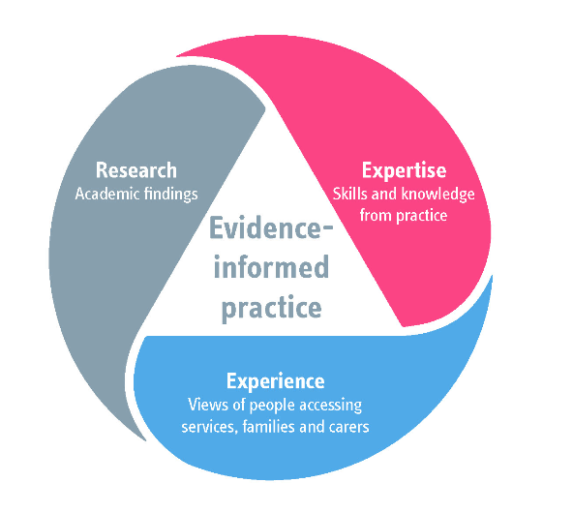
Research in Practice
We work with and for professionals in the social care, health, criminal justice and higher education sectors offering resources, learning opportunities and specialist expertise.
We aim to support their learning to enable people – children, young people, families, adults, carers and communities – to live good lives.
Our work brings together research evidence, practice wisdom and expertise from people’s lived experience.

Slide 2
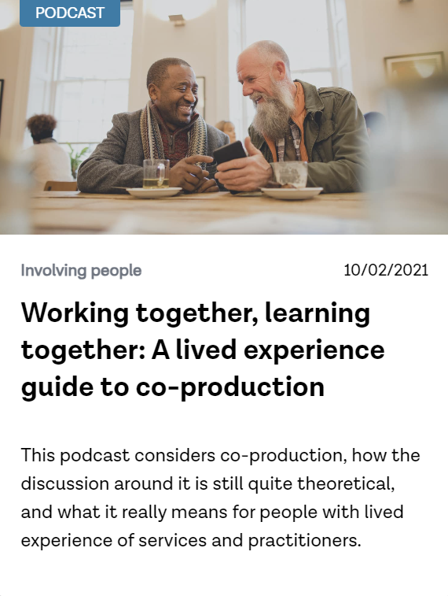
The beginning of a journey…
Working together to promote Social Care Future’s Work
A different approach to an evidence review: evidence from research and from lived and learned experience
Co-production as an underpinning principle
Building on existing resources (podcasts, publications, films)
Notes:
Welcome to this reflective session on Neglect and poverty aware practice.
Introduce myself

Slide 3
Next steps…
Development of policy around working together and paying people
Embedding co-production principles across our work
Sharing learning from the Evidence Review across our partner network
Launch event – 15th December 2023
National Children and Adult Services Conference workshop

Slide 4
The five Key Changes…

Slide 5
Structure of the Evidence Review
Arranged according to the Five Key Changes
Within this, themes emerged from the groups, which then provide further structure
Each theme contains:
1. What this means
2. The research
3. What you can do
4. Further information
Also contains direct video, audio, written contributions from co-producers
All web-based and interlinked
Notes:
These sections will be clickable on the website – so you can see them if you want to.

Slide 6
1. What this means
Brief text that represents the co-production group’s views on what this means and why it’s important
Augmented by video material
Direct quotes specifically highlighted
Peer review on this section was limited

Slide 7
What does Leading The Lives We Want To Live mean to you?
“Having the same opportunities as other people, including other non-disabled people. Being asked about our aspirations and being supported to progress as we would like to… very much I notice that people seem to be stuck in a rut when they have to draw on social care services. So rather than being asked “how would you like to live your life” it is very much narrowed down to “this is what we support you with”.
Notes:
0.12 – 1.15

Slide 8
What does sharing power as equals mean to you?
“Attending any situation where you are considered to be just as important as all other people there. Your voice is heard, listened to, and more importantly, used to make a difference”
Notes:
Show 00:19-00:45

Slide 9
2. The research
Lived experience was the starting point rather than the research itself
Some research was discussed in our group sessions, whereas others was picked up in the writing up
Different to a comprehensive literature review and kept in mind presenting the research in an accessible way
Links with all other relevant sections for navigation

Slide 10
3. What you can do
Calls to action for everyone – direct work, managers, commissioners, providers, senior leaders, and those who draw on social care themselves
Direct suggestions from the groups and some added in during writing up – things that made sense from the research recommendations

Slide 11
4. Further information
Lots of stuff to read, watch, investigate!
Directly related to the What You Can Do sections wherever possible
Again, many resources came from group suggestions during meetings and/or later

Slide 12
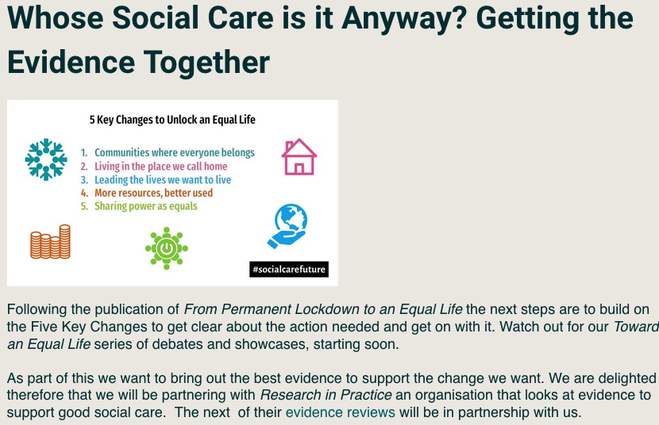
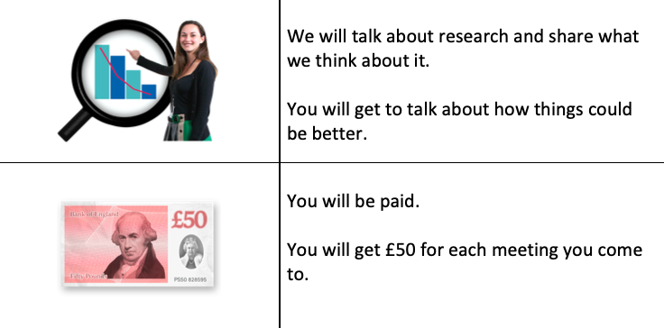
How we did it

Slide 13
Reflections on the process: from me
Exciting
Hard work
Lengthy
Eye-opening
Reflective
Complex
Relationship-based
Multi-layered
Learning curve
Perspective-shifting
Sensitive
Needs support from organisation
Need to establish milestones
Won’t end on publication – sense of responsibility

Slide 14
What we learned
Lived experience is one of many things that shapes people’s views
Individual conversations as well as group debates are vital
Pay people fairly and smooth out, as far as possible, processes for payment
Set realistic deadlines and be prepared for change to these
Take the potential emotional impact on everyone very seriously
Tell people! Share! Get and stay excited by the project you’re doing!

