Slide 1
“Fixing the social care plumbing & wiring”
People tell us rules, regulations and ways of working get in the way of good change, such as:
National laws, policies, regulations and info collection
Local policies and customs, ways of commissioning, assessment, controls, info systems etc.
Systems of public procurement, financial accounting, demands of insurance providers etc.
Some of these things can be changed locally, some need national change
We want to see what we can do about this – hence this project
Notes:
We are a very diverse movement of people who want to see big change for older and disabled people who need some support to lives their lives. People who draw on social care are at the heart of our movement alongside lots of different allies – professionals, system leaders, academics, workers, support providers and more

Slide 2
“Fixing the social care plumbing & wiring”
There are linked national and local parts
Nationally we have got commitment from organisations with influence to be involved in looking at the main issues that need tackling and start to tackle them
We will be talking with lots of different people about what are the main issues and how they might be tackled
We will get together with the national organisations to see what can be done
Locally we want to support local people and councils to work on things they want to change
And we want to include the local “plumbing and wiring” issues we find in the local work in the national work – especially where it needs national action to change them
Notes:
We are a very diverse movement of people who want to see big change for older and disabled people who need some support to lives their lives. People who draw on social care are at the heart of our movement alongside lots of different allies – professionals, system leaders, academics, workers, support providers and more

Slide 3
Working Together for Change
Notes:
May seem a bit overwhelming – don’t worry – bit like driving a car
Holiday exercise?
Timing / informal / help make sure the pace is right
More detail in the facilitators packs you have

Slide 4
About the methodology
Working Together for Change is a simple collaborative process for coproducing change first written up and published as best practice guidance for commissioners in 2009
Supports The Care Act Market Shaping Duty “that market shaping and commissioning should be shared endeavours…”, and Commissioning for Better Outcomes standard 4 that Good Commissioning is ‘Coproduced with people, their carers and their communities”-
It is highly scalable and can be used in different contexts to coproduce change and improve strategic decision making
There is a live and vibrant community using and adapting the process and sharing their learning

Slide 5
Building our coproduction muscle

Slide 6
Overview of the Eastern Regional programme
Six sites-
Milton Keynes Suffolk Essex Hertfordshire Central Bedfordshire Southend
(Cambridgeshire)
open learning environment
Webinars
Anti poverty strategy
SENSORY SERVICES REVIEW
ALL AGE AUTISM STRATEGY
GATEWAY TO SERVICES
POST WORKSHOP FOLLOW UP
DEALING WITH DIFFICULT DYNAMICS
Online resource pack
Community of practice

Slide 7
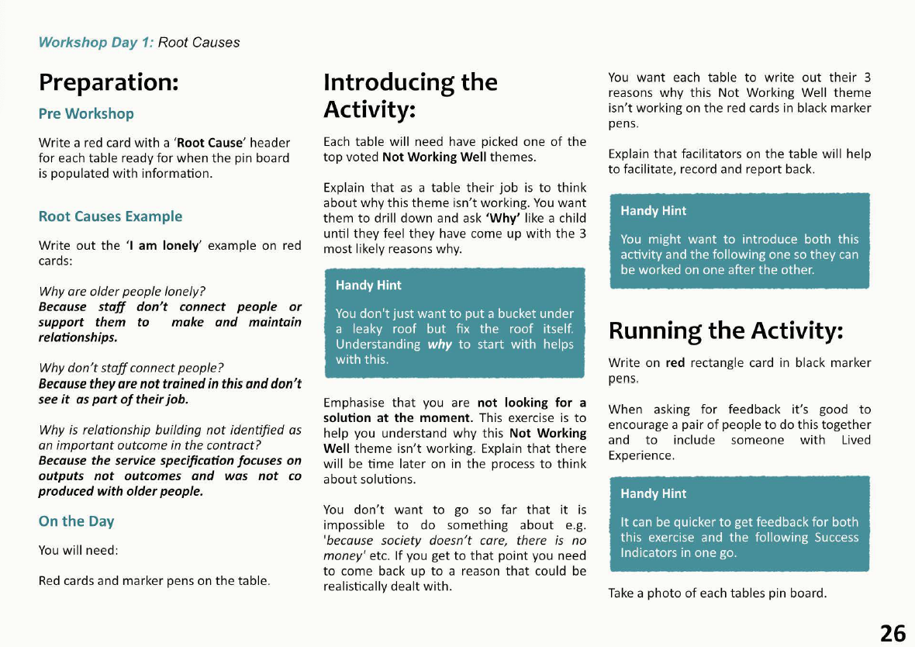
Resource Pack

Slide 9
Compiling a 360* view of the issue based on 3 core questions
Question | Why ask this?
“What’s working well now” | Identifies what elements are working well that can be built on
“What’s not working” | Explores the key things which are preventing positive change and having a negative impact
“What’s important in the future / What would make the most difference” | Clarifies what we want to be different and what impact that would have

Slide 10
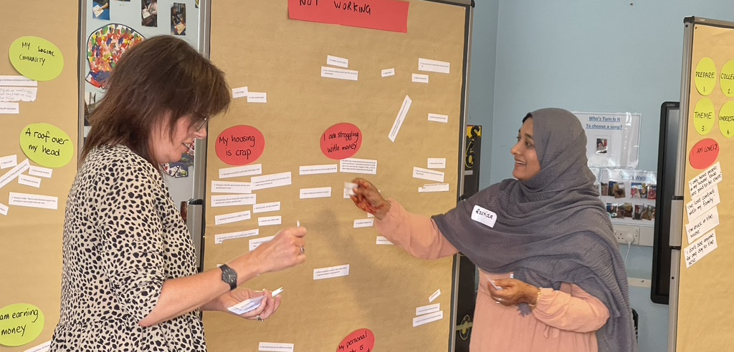

Slide 11
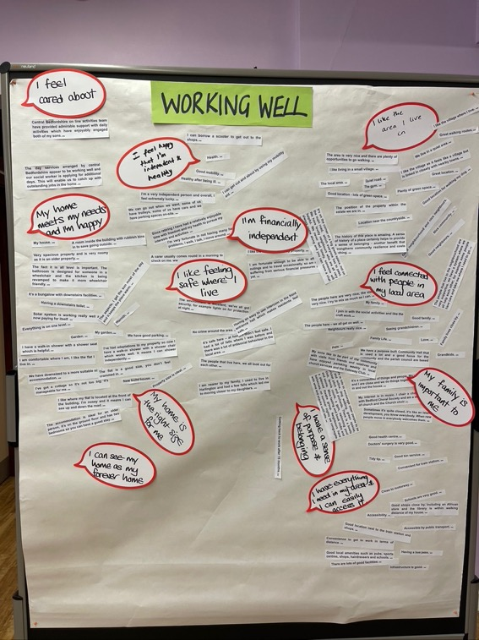
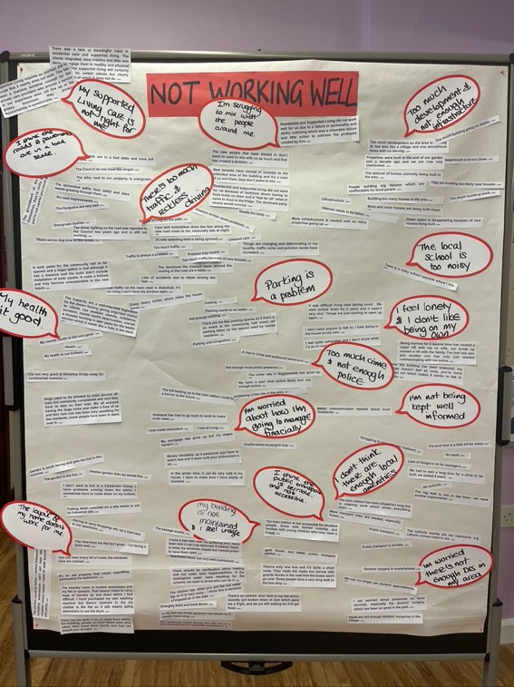
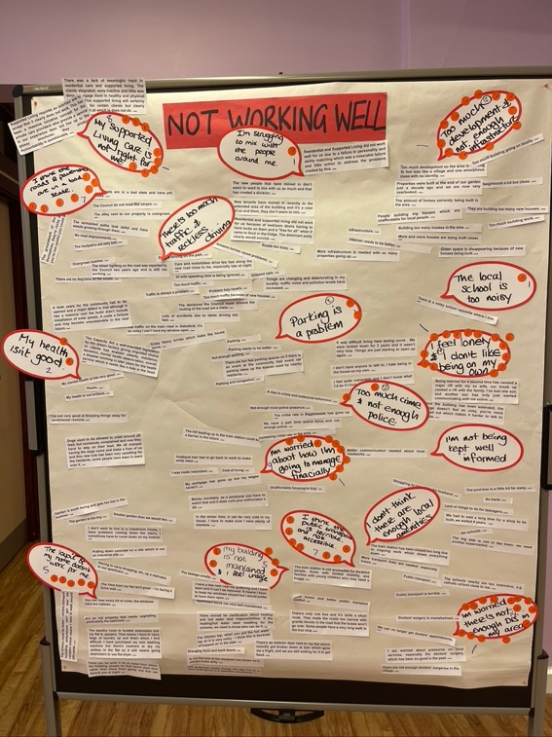
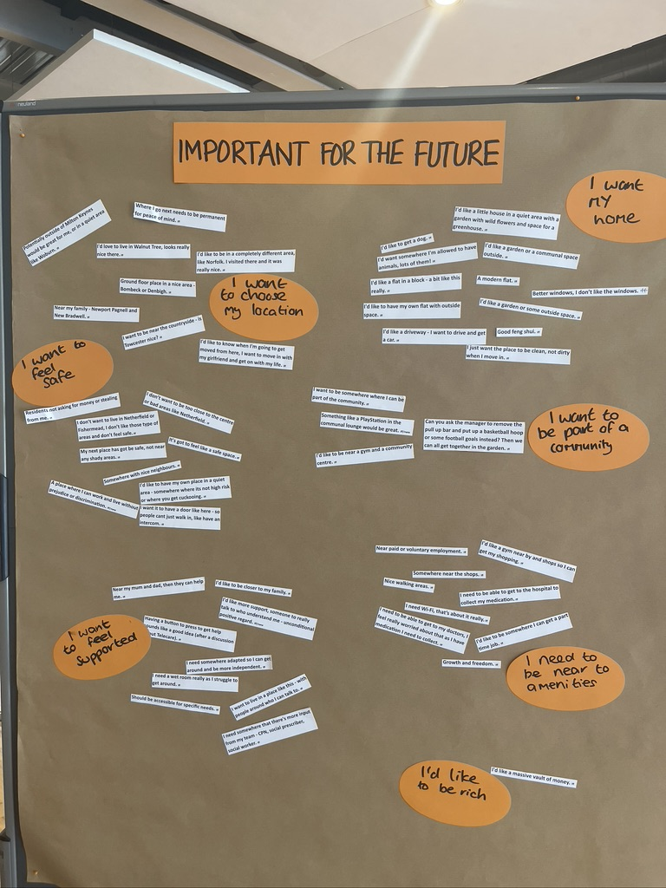

Slide 12
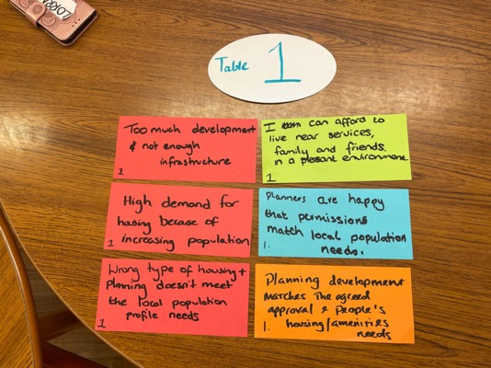
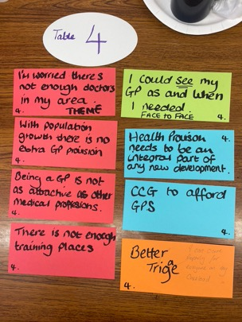
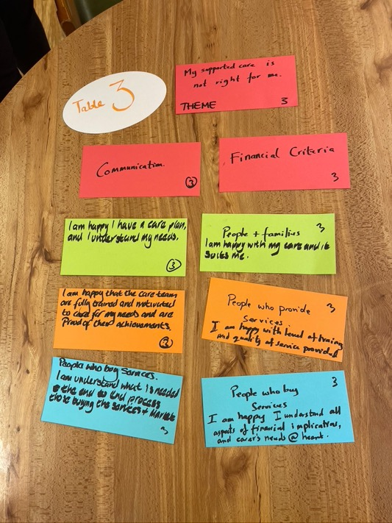
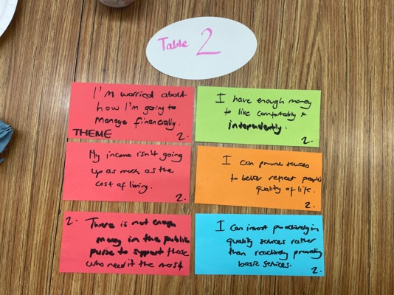
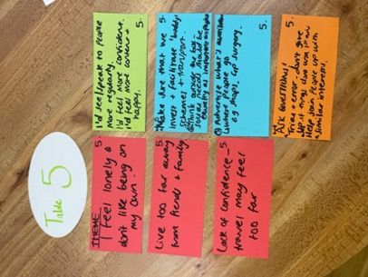

Slide 13
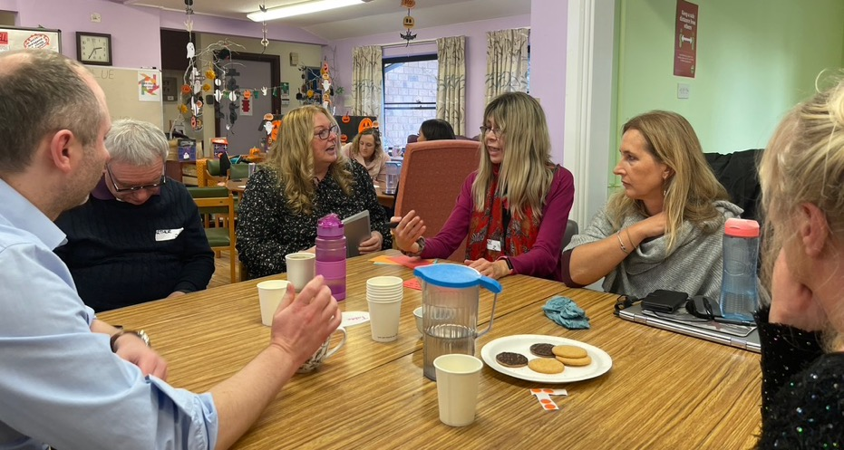
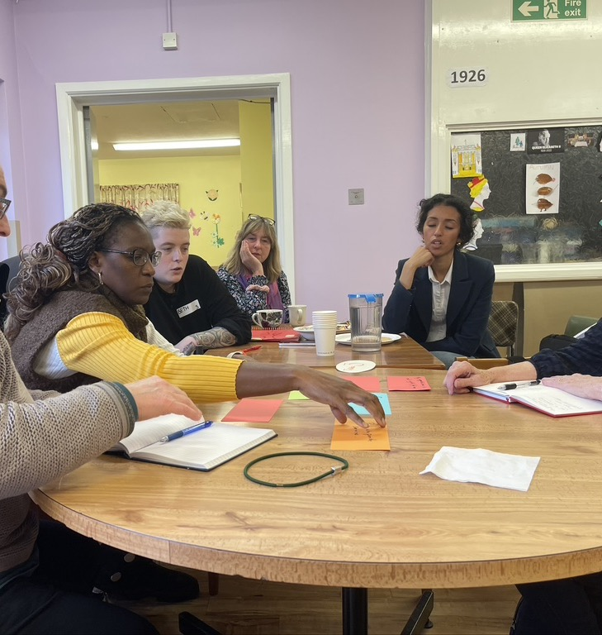
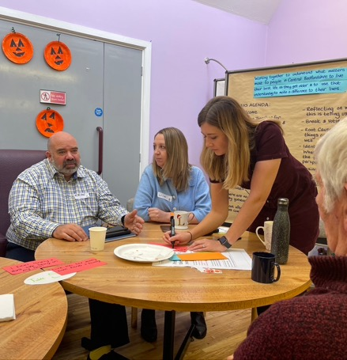
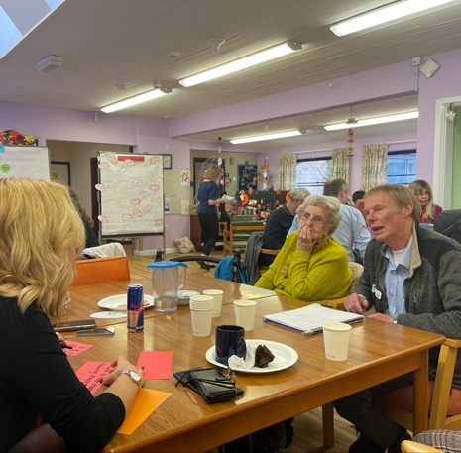

Slide 14
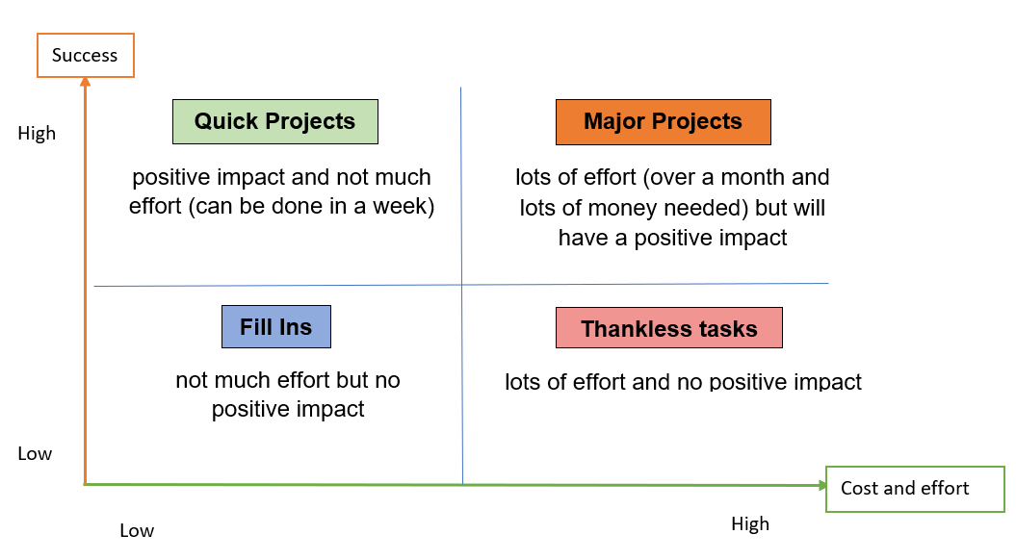
Mapping possibilities
Grouping ideas for effort required and likely impact
Notes:
Run this one if we have time

Slide 15
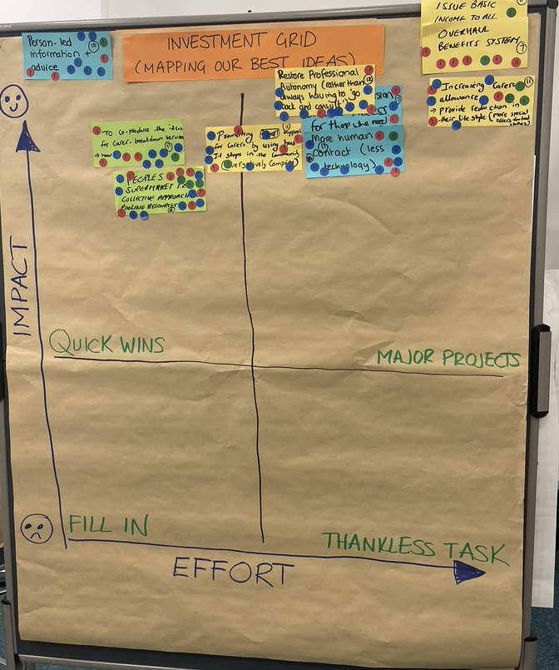

Slide 16
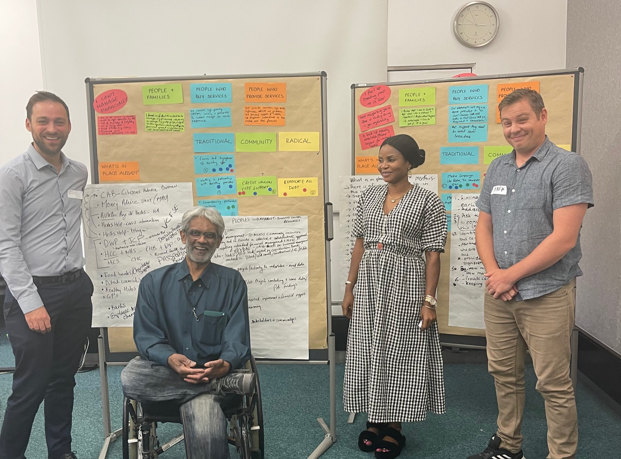

Slide 17
Areas of focus
Direct Payments x 2
(Accessing and setting personal budgets including DPs)
Flexible carer breaks
How specialist services might make it harder for people to get the right support at the right time
Getting better at prevention / Developing a Community well being hub

Slide 18
What key plumbing and wiring issues might we be missing?
Whose voices do we need to hear to get a really rich understanding of the issue?

Slide 19
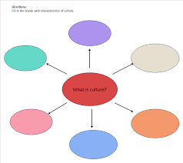
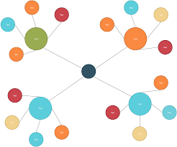

Slide 20
What would be the most powerful and influential ways to press for action on our findings?

