Slide 1

Access Social Care
October 2023

Slide 2
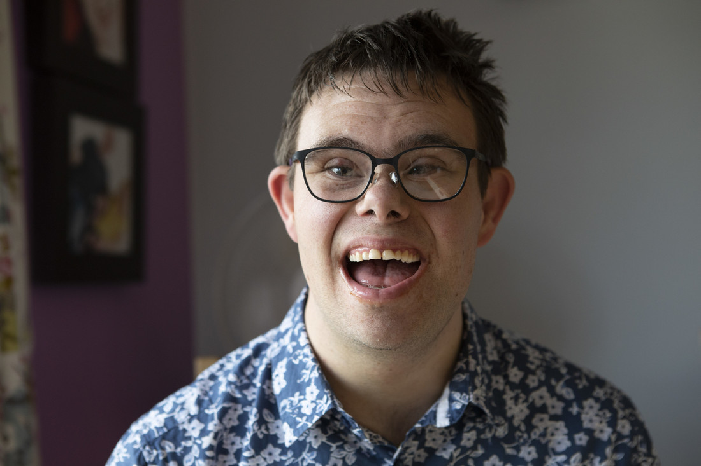
About us
A legal organisation with a difference
Working with communities and public bodies to uphold the rule of law.
Collaborating to ensure better outcomes
Shaping a future where social care is adequately funded.
Notes:
Access Social Care is a relatively new organization that span out of Mencap in 2020.
We are a specialist health and social care legal rights charity.
We exist to make sure that that people get the social care they have a right to
When people think about the law they tend to think about court rooms and conflict
But having grown up within social care providing organisations, Sense and Mencap, we have evolved a collaborative approach
We passionately believe that Using the law and rights based language early on can help avoid conflict and secure better outcomes. Helping people flow through systems more effectively.
We also believe that when done right, rights based work including legal casework can function as a learning tool to help public bodies identify thematic problems with policy and practice and improve quality

Slide 3
How we work – connecting our expertise to other organisations
Access Legal network
Member org.
Member org.
Member org.
Member org.
Social care organisations pay a subscription so that their staff and beneficiaries can benefit from our service
Notes:
Since 2018 we have been connecting our legal expertise to other organizations through a membership model.
Our members are helpline organisatons and social care providing organisations.
They pay a membership fee and we provide:
Legal education to increase confidence in using legal and rights based language to improve outcomes
We provide one off advice and casework support to people with social care needs . We have a 98% success rate with our early intervention casework. Where we are not able to successfully resolve the case with the local authority we refer the case out to solicitors.
- WE gather data about our work, we merge this data with data from other sources and we use it to inform influencing and strategic work to drive system change locally and nationally.
Our membership is growing, but the problem with our membership model is that small community based organisations working with underserved communities can’t afford our fees.
There is a body of evidence that shows by providing access to justice on social welfare issues , you can improve health and social care outcomes.
Our hypothesis is that by targeting our work at communities with experience of health and social care inequalities, we will be able to improve health and social care outcomes.

Slide 4
1. Legal capability training , data capture
2. Referrals – legal advice and casework
3. Data capture and analysis
4. Influencing and strategic casework
5. Our communities hold public bodies to account
6. Improved outcomes, confidence in the rule of law
Changing the system in our local hubs
Reaching those who need us the most
Co-produced service model
Secondments
Technology
System change
Notes:
Since 2020, with funding from trusts and foundations we have been working in a place based way with disabled person led, carer led, black led and Asian led organisations in the SW and the SE.
We started by seconding people from partner organisations, including disabled person led Inclusion Gloucestershire, black led Croydon Social Prescribers and Black Thrive and Asian led Friendship Café, into Access to learn about how we use the law early on to avoid conflict and improve outcomes.
We work with those community leaders to co-produce training to ripple out into communities.
Through training sessions and reflection sessions we gather qualitative data about the issues experienced by local people
Having identified themes our legal caseworkers run groups of cases to delve into identified issues to help us understand the root cause of the problems.
In Gloucestershire we identified that there were problems with the information that was being communicated to people with social care needs about assessments and charging.
We were able to take this data to the council to start a conversation about how changes to content on the website and letters sent out to citizens as well as staff practice on the contact centre could make a big difference for people flowing through the system, helping to improve right first time decision making

Slide 5
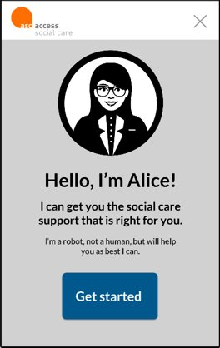
What is a chatbot?
An automated legal advisor
Available 24/7 and free at point of use
Helps users to answer legal questions, points them to legal resources
Helps triage cases
Notes:
We are using technology to help us
We have developed a legal information chatbot that provides free legal information 24/7
The chatbot is unique because it is outcomes focused. It guides users to letters developed by our legal team that can be personalized within the chatbot ready to send off to the public body.
There are over 50 different letters – including letters that help people request an assessment or raise a safeguarding concern effectively.
We are working with trusted intermediaries in underserved communities to encourage use of the chatbot
Again helping people to use rights based and legal language to ask for their needs to be met.
We have been testing the chatbot with the Black and Asian communities in Croydon and in Gloucestershire and early evidence is that it is helping people to get the right outcome faster and on the first time of asking.
One social prescriber who had been trying for over 6 months to get an assessment for a patient where there was a safeguarding concern, told us she was contacted on the same day by the local authority to arrange a desperately needed assessment.

Slide 6
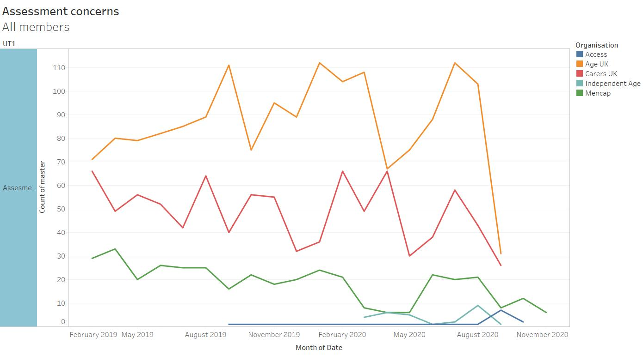
Helpline data project :
Notes:
The chatbot helps us to capture data about patterns of advice demand
We overlay this data with data from other sources including national helpline data
So that we can see geographical and thematic patterns relating to problems with policies and practice.
As this data set grows it will become increasingly informative for local authorities.
In Gloucestershire our quantitative data identified that there were problems with assessments, charging, respite and continuing healthcare.
We provided some case work support to a group of families to help us to learn more about these thematic issues. We learnt from our casework that rather than there being a problem with respite, many of the issues were rooted in a failure to provide accurate and timely information to citizens about their right to an assessment. We took our learning to the local authority. We are now starting to work with the local authority – to explore how we can collaborate, using our data to improve quality.
At the same time, we are providing our data back to partner organisations and local citizens empowering them to use the data to influence.

Slide 7

Increasing our impact – hosting the chatbot on partner websites
NAS
Carers UK
Croydon BME Forum
Asian People’s Disability Alliance
Notes:
We are licensing the chatbot to other organisations – this year we are onboarding National Autistic Society, Carers UK as well as smaller organisations such as Croydon BME Forum and Asian People’s Disability Alliance
We are working with groups of users to iteratively improve the chatbot content and user experience as we go. By working with community partners we have learnt that we need to integrate more content around the cultural appropriateness of the assessment and care planning process. This year we will also be improving our carers , charging and continuing healthcare content.
At the moment the chatbot product has been designed to sit on helpline and community organisation websites
But in the future we can see that a different version of the product could sit on a local authority website, helping to reduce demand on the contact centre and improving the customer journey for people seeking social care.

Slide 8
Improved
social care outcomes
Improved
relationships
with citizens, increased trust
Improved flow
through system,
early
intervention
How the model works:
Legal
capability
training
Communities use chatbot letters rights based and legal language
Reduction in health and social care inequality
Qual and quant Data
capture
Change to
policy
and practice
Communities receive advice and casework
Notes:
This is a very basic version of our theory of change.
Our hypothesis is that our intervention can:
improve health and social care outcomes, and reduce health and social care inequalities
Improve flow through the system because by using legal language, people’s needs are more likely to be met, driving greater investment in early intervention
And it might seem counter-intuitive but independent research from A Professor at UCL and a Doctor at Glasgow University has shown that our intervention can actually improve relationships between families, providers and local authorities.

Slide 9
How we work – collaboration
Mike Walsh is the Team manager for the Forest of Dean community learning disability team and the local Lead for LD Speech and language therapy. Julie is our legal caseworker.
“Julie made sure that the family had a voice. She channeled and reflected their views in a rational and reasoned way using legal frameworks. This helped reduce conflict despite heightened emotions. Julie ensured that the voice of the person with a learning disability were central to decision making. We made good progress.
I reflected on another similar case where there have been 2 or 3 years of issues and family members with heightened anxiety. I believe this case has not progressed as well because there has not been any input from ASC”
Notes:
We know that our work can Help improve relationships between public bodies, families and providers
I wanted to show you this quote from Mike Walsh, who is the Team manager for the Forest of Dean community learning disability team and the local Lead for LD Speech and language therapy.
Mike was the public body representative contacted by one of our legal caseworkers , Julie, in relation to a young woman who was in crisis because her placement was close to break down.
Mike said, “Julie’s presence made sure that the family had a voice. She channelled and reflected their views in a rational and reasoned way using legal frameworks which helped reduce conflict despite heightened emotions. Julie also ensured that the voice of the person with a learning disability were central to decision making. We made good progress on the case. I reflected on another similar case where there have been 2 or 3 years of issues and family members with heightened anxiety. I believe this case has not progressed as well because there has not been any input from ASC”

Slide 10

We want to work positively with public bodies to secure better outcomes for the people we support
We have a 98% full or partial success rate with our cases
Notes:
The Equality and Human Rights Committee’s recent inquiry into challenging adult social care decisions heard that some people are not given crucial information about how to challenge decisions, and under half of the local authorities surveyed always signpost users to independent advice or support.
The EHRC found this creates unnecessary barriers for users and fears of negative consequences if complaints are made, including loss of access to the social care needed.
There is also poor collection and analysis of equality data.
The EHRC found This missing information could help councils to understand how well they meet the social care needs of different groups, so services can be improved.
We are a legal organisation and we do exist to make sure that people get the social care they have a right to. But we believe there can be a relationship that sits alongside that challenge.

Slide 11

A pilot project?
We are looking for:
5 authorities, each contributing £10k
We would host the chatbot on websites of local partner organisations working with marginalised communities
Working with SCF we would:
  Deliver Care Act training,
  Hold reflection sessions to help communities understand how the law can be applied
  Promote and support use of the chatbot
  Hold workshops to inform iterative improvement of the chatbot
  Harvest qual and quant data
  Work with citizens so they can tell you about their experiences
Notes:
Stage 1 – note that the number of organisations we could host the chatbot on will depend on the size of the organisation and the number of website visits the organisations usually receives– the more that chatbot is used, the more it costs us (computation costs).
Stage 2 – we could build the project out, hosting the chatbot on more websites,
- Fund secondments to run train the trainer sessions to skill up local people to ripple out PLE workshops
We could recruit a legal caseworker to conduct some legal casework to understand more about the issues
Stage 3 – we could look at how we could repurpose the chatbot product to help public bodies reduce demand on their contact centres whilst improving flow through the system and first instance decision making

Slide 12

Thank
you
Notes:
Thank you for listening.

