Slide 1
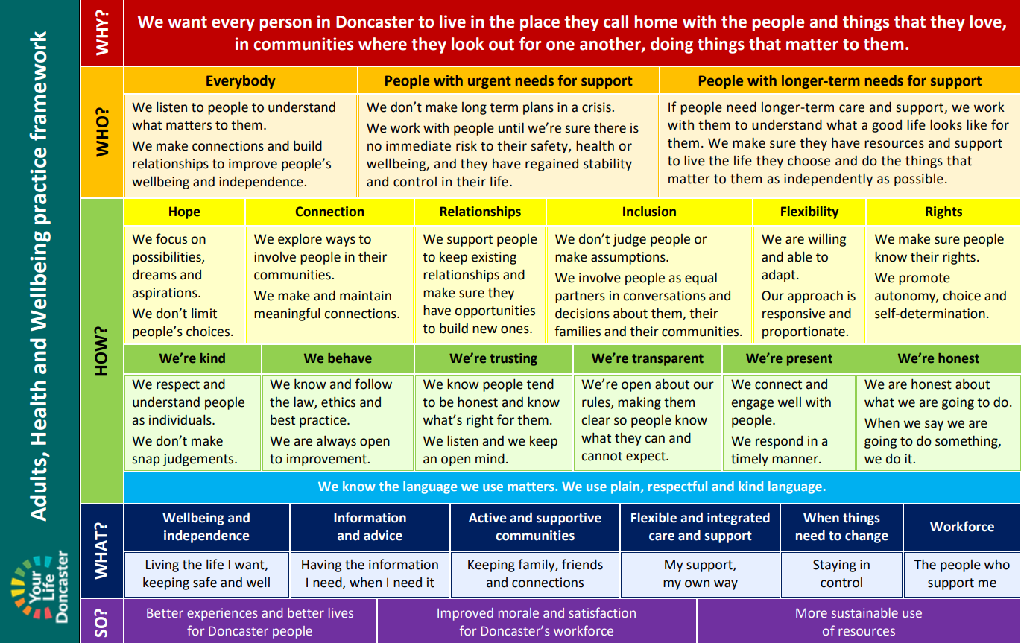
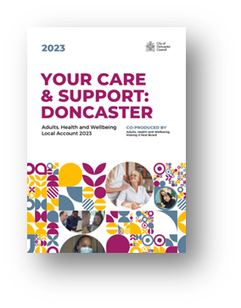
Reimagining care and support in Doncaster Bryony Shannon Strategic Lead for Practice Development Adults, Wellbeing and Culture City of Doncaster Council October 2023

Slide 2
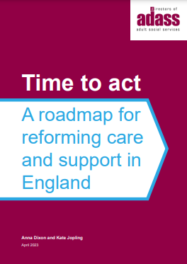
Reimagine care and support with people who draw on it
The aim is to co-produce a local strategy and approach to care and support – many areas have chosen to do this using the Social Care Future Vision, and Think Local Act Personal’s (TLAP) Making it Real framework.
This will lead to a shift in the language and cultures of social care practice to emphasise individuals’ rights, the pursuit of equity and justice, and professionals’ roles as enablers.

Slide 4
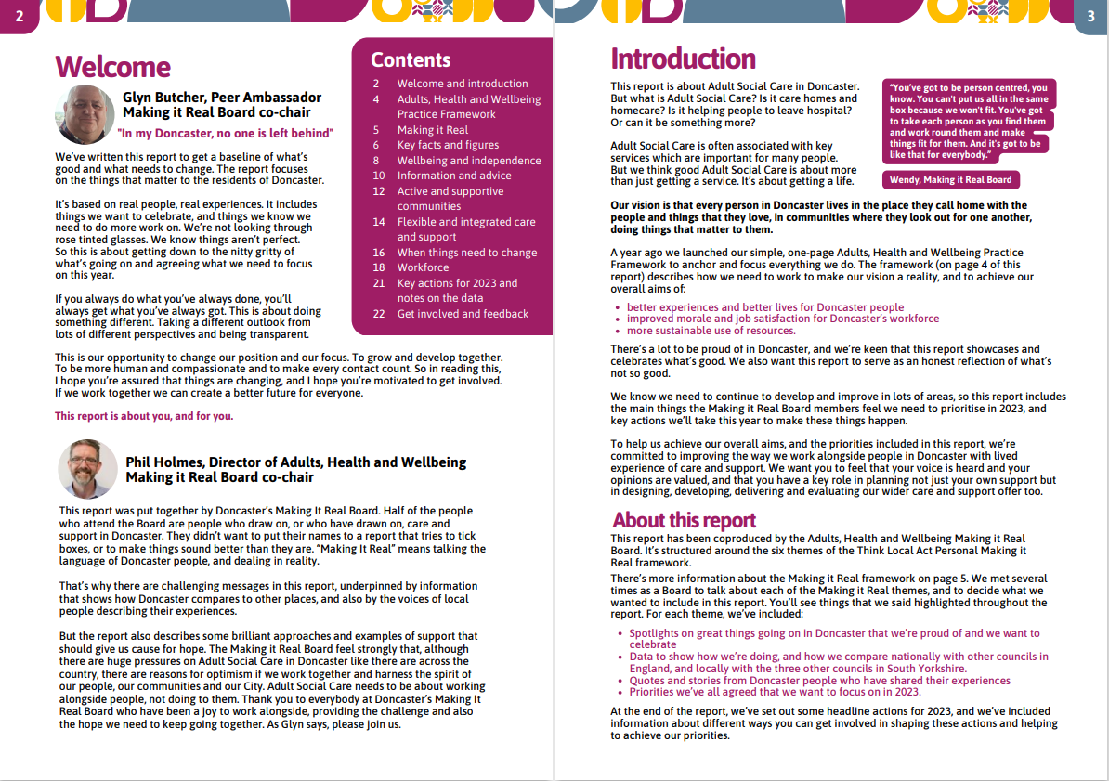
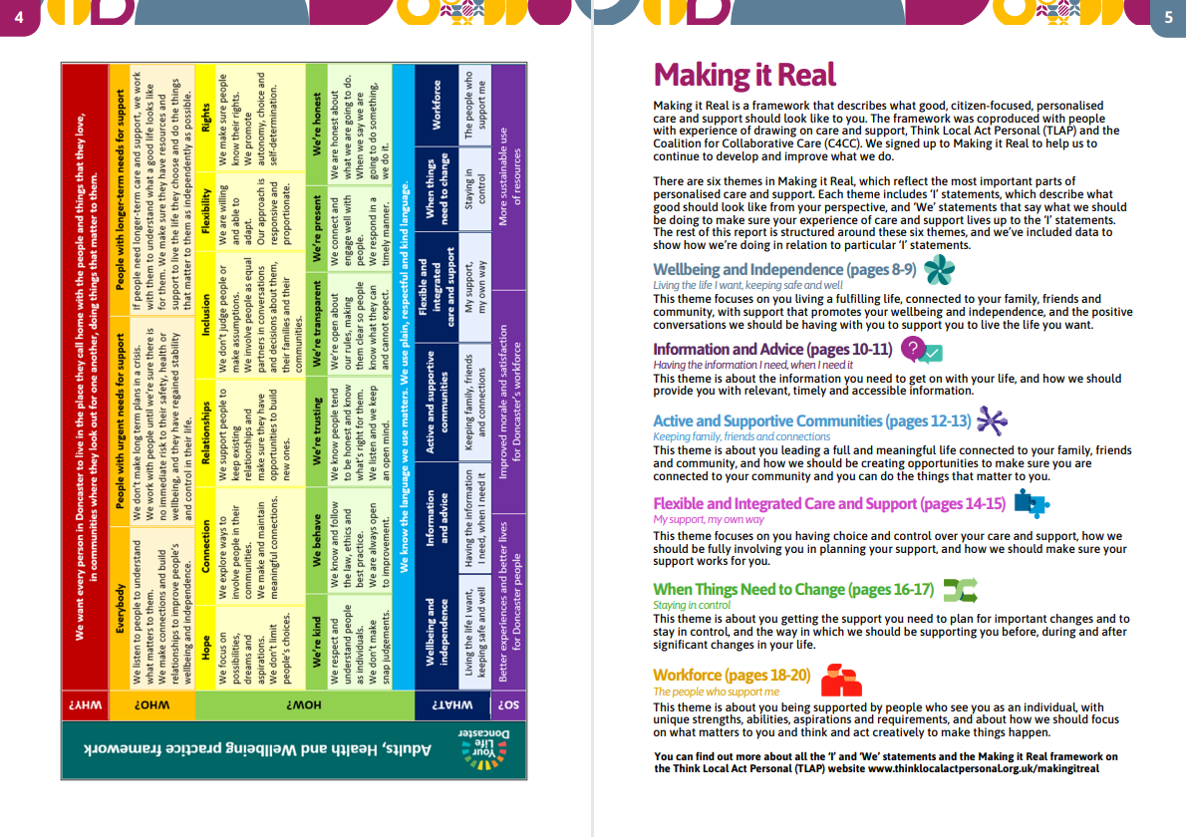
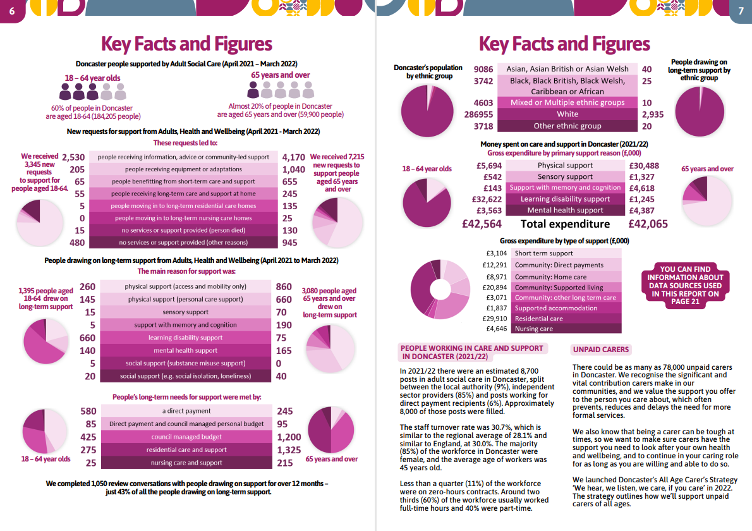
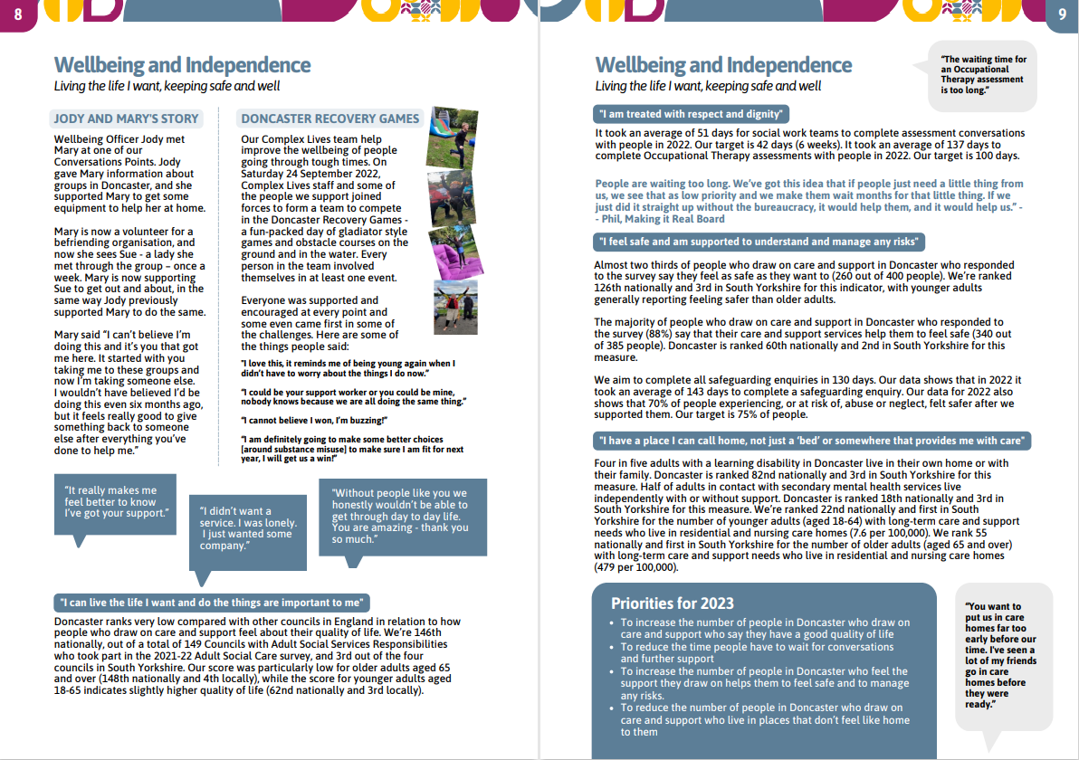
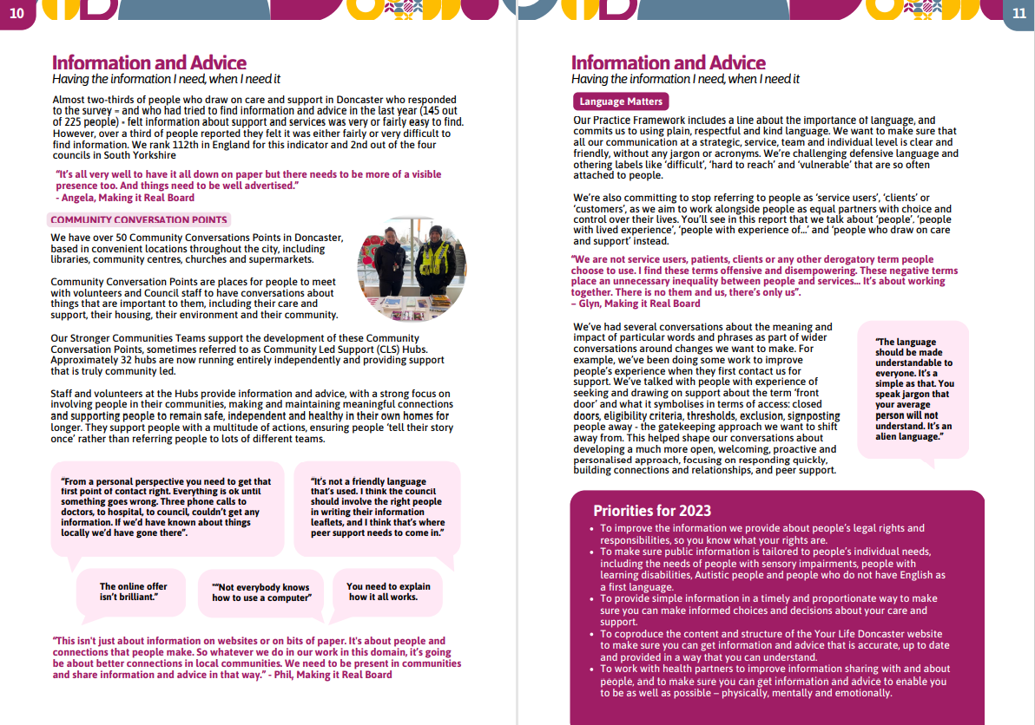
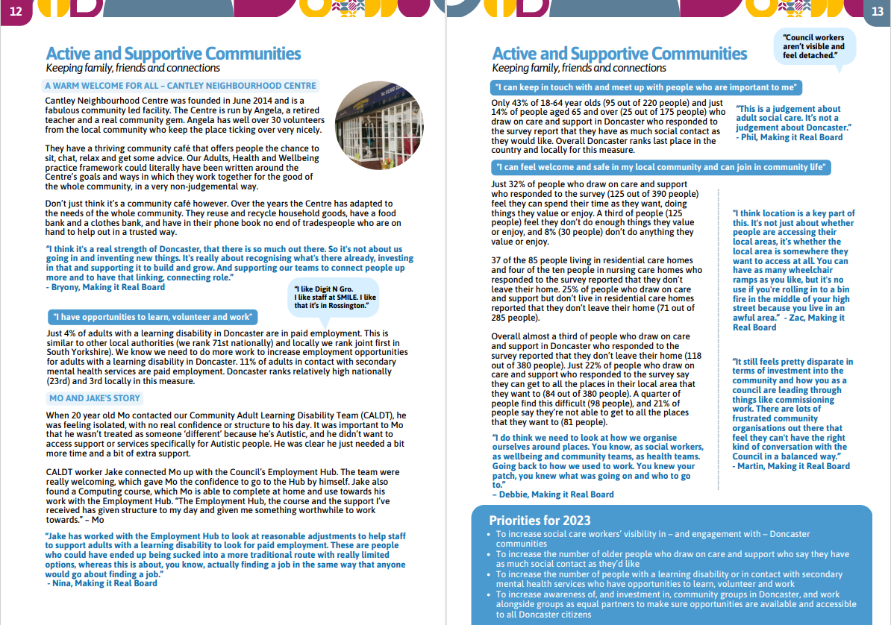
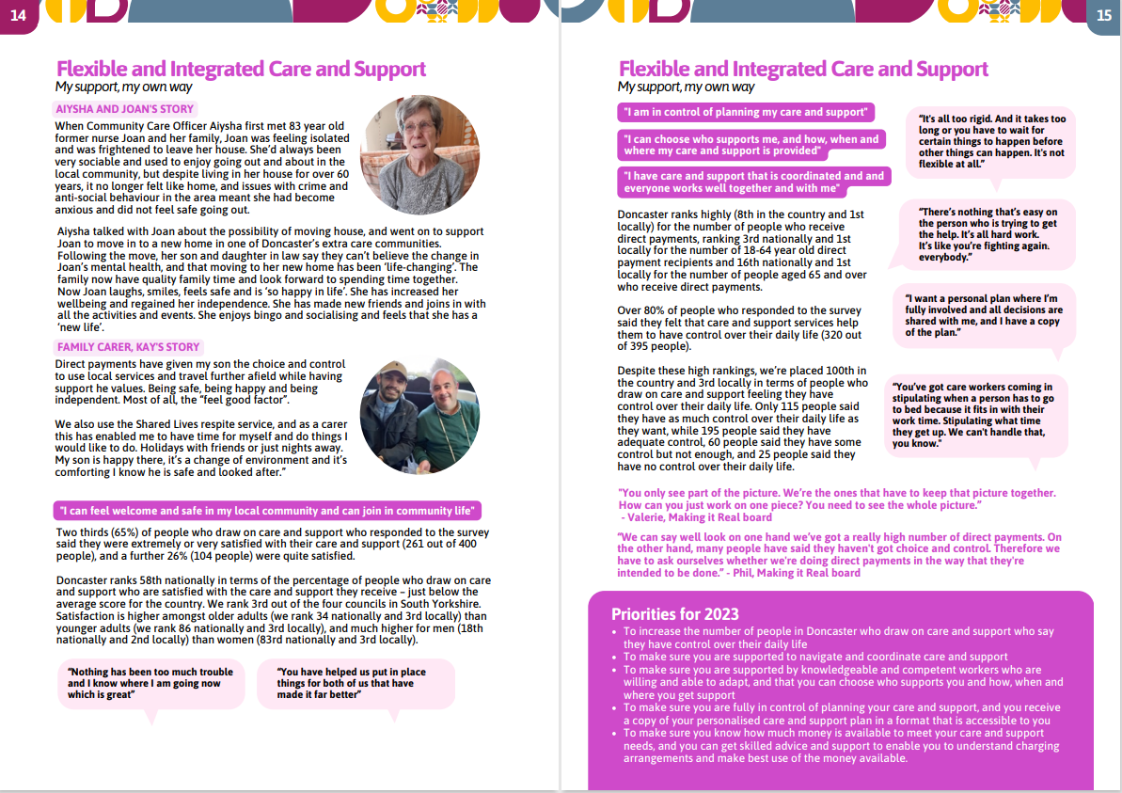
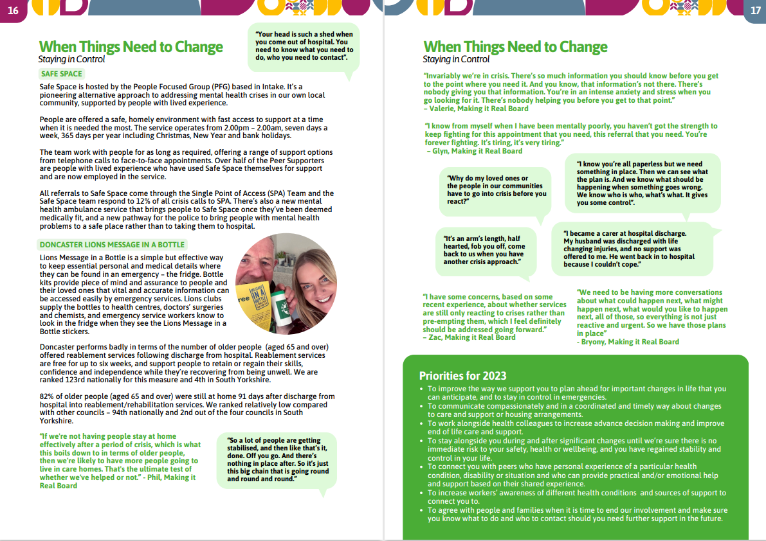
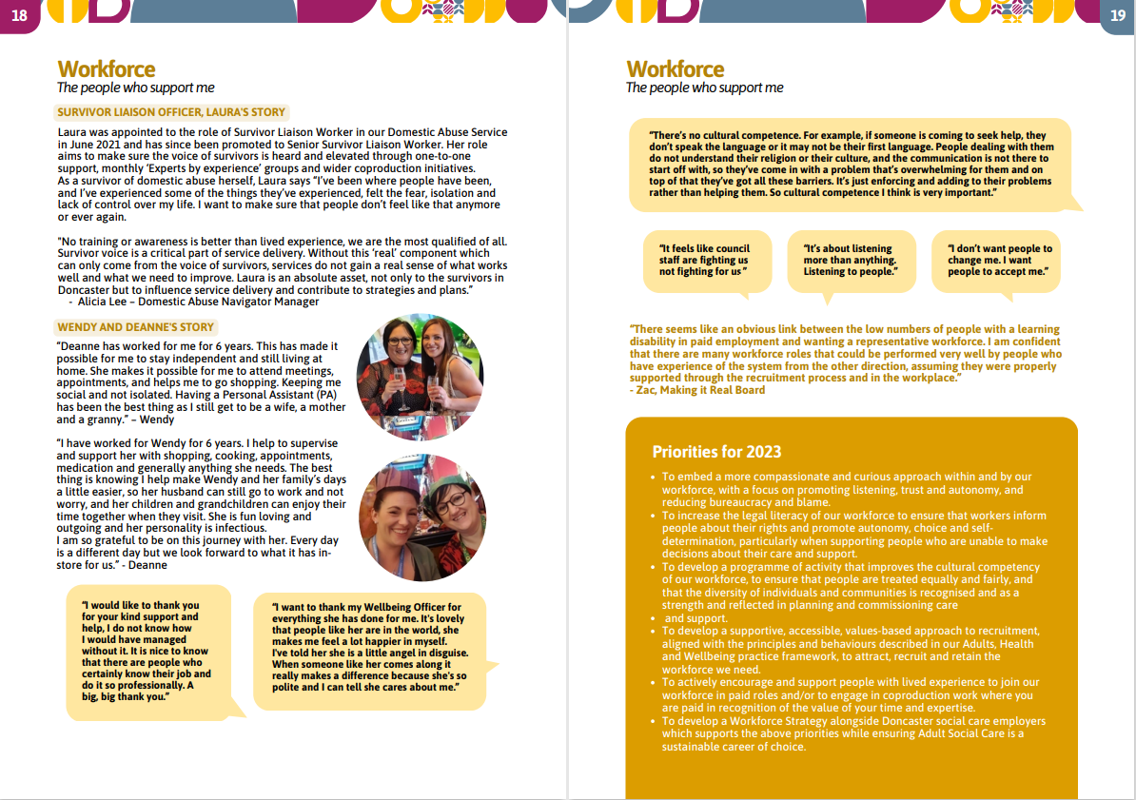
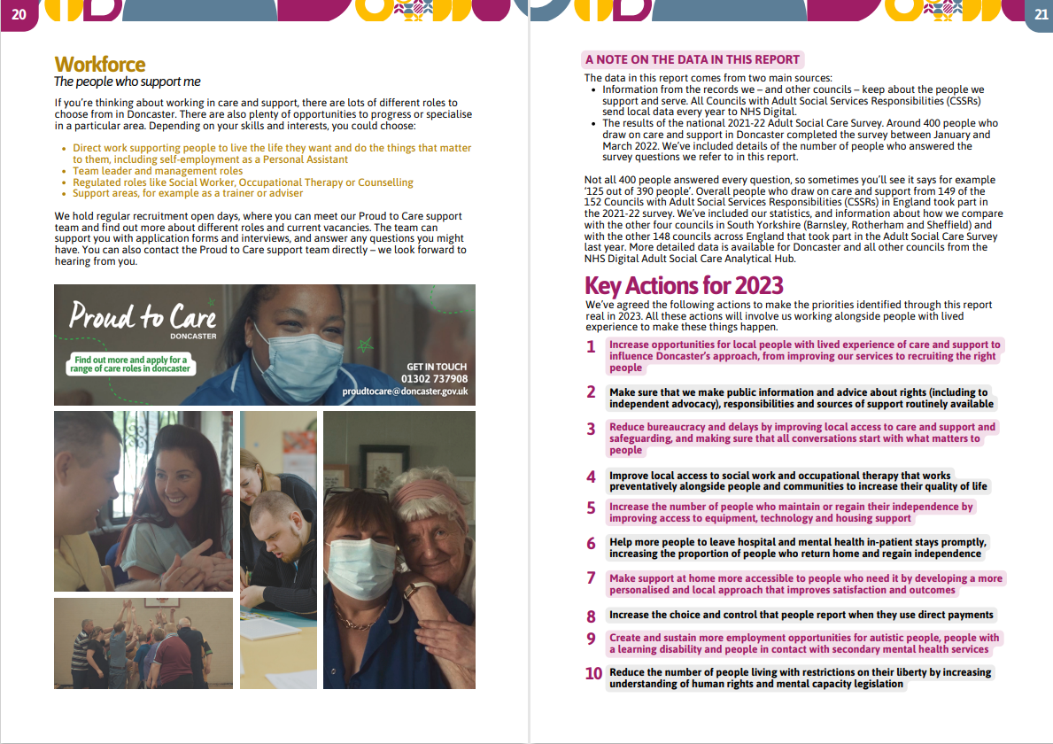
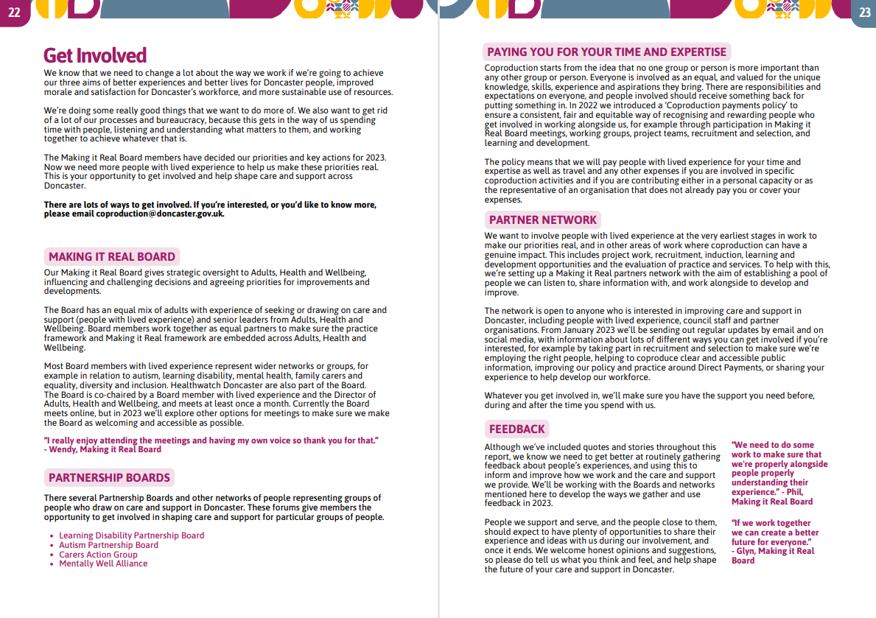
Your Care & Support: Doncaster

Slide 5
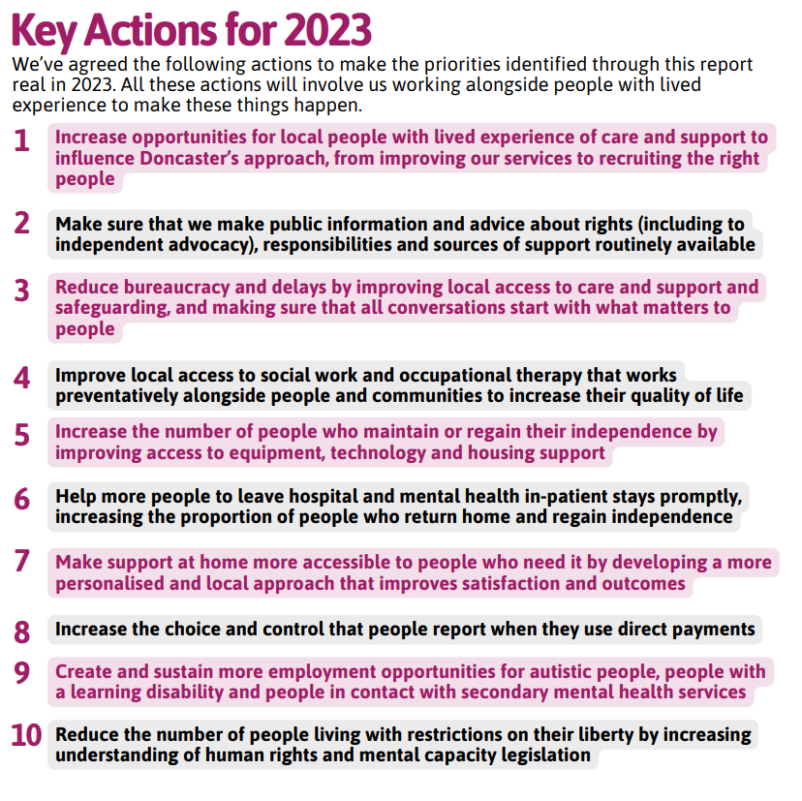

Slide 6
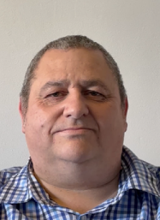
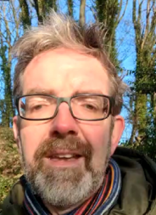
Your Care and Support : Doncaster 2023 - Adults, Health and Wellbeing Local Account
Watch and listen to Glyn Butcher, peer ambassador and co-chair of the Making it Real Board, introduce the report
Watch and listen to Phil Holmes, Director of Adults, Health and Wellbeing and co-chair of the Making it Real Board, introduce the report

