Slide 2
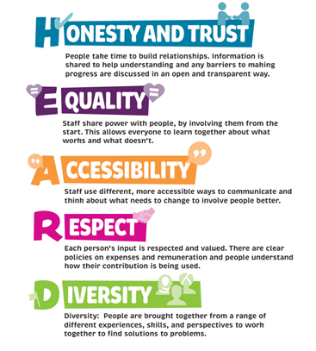
Where did we start?

Slide 3
Better Together

Slide 4
Practice framework
It shows 6 key ‘how’ ways we will work towards the Social Care Future vision and Making it Real Statements
We asked people about these in the Big Conversation

Slide 5
Getting Help

Slide 6
Where did we start ?
https://youtu.be/qUz0lmJdzr0

Slide 7
8 big listening events
2 surveys
11 meetings or sessions with groups

Slide 8
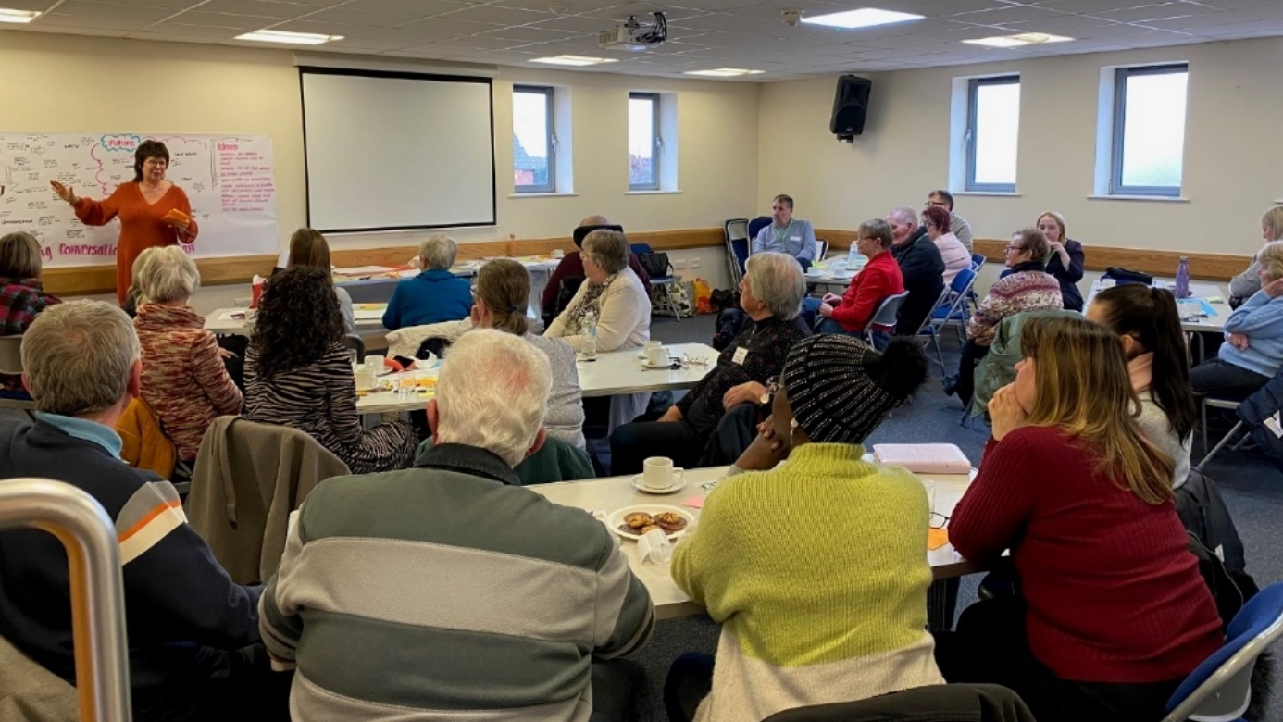

Slide 9
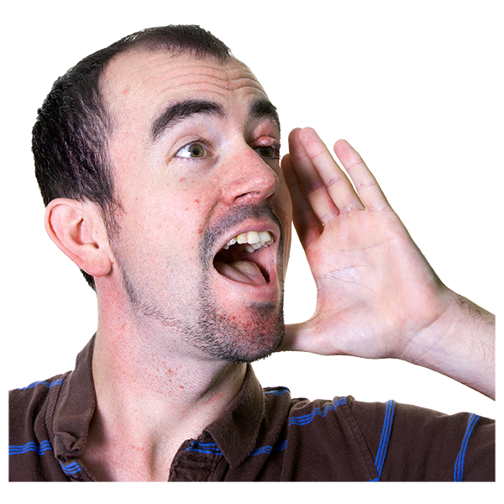
We heard from 542 people who draw on social care or are family carers
Notes:
.

Slide 10
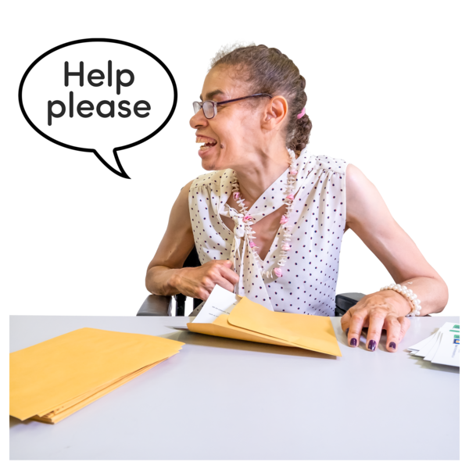
Support to live your life
People talked about the pressures on paid care workers and how these impact on them and the care they received
Some people shared very positive experiences of good support
Some people shared negative experiences of poor support
They do their job well but they certainly aren't paid enough
Does the support you get help you live your life the way you want to?
They treat me with respect and help me to live as I want to
They are doing the best they can which sometimes means I don't get what I want

Slide 11
What happened next ?
Actions for individuals - senior listeners took issues away to sort.
We shared the Big conversation report widely
We have had conversations about some issues we need others to help ix e..g bus passes
We have been working on co-designing our local account, and priorities

Slide 12
Our Local Account: Pulling it all together
Inspection
Local Account
Priorities
Self-Assessment

Slide 13
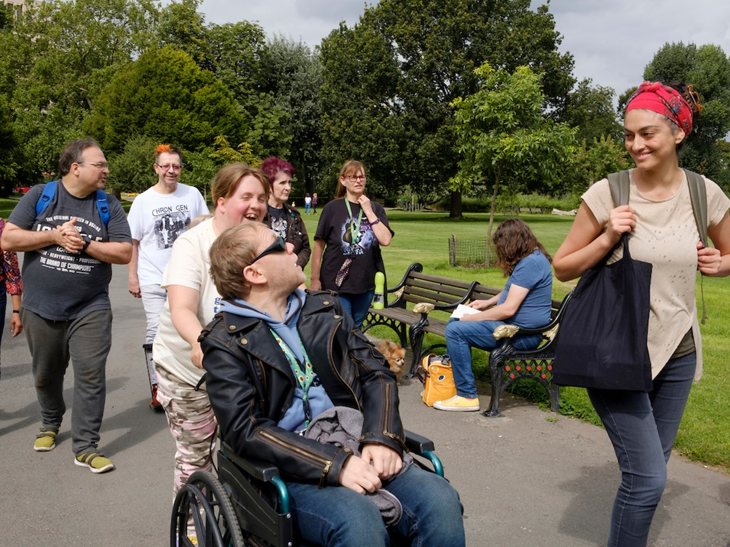
A public facing plan
Local Account is being co-designed with people in plain English – By people for people
Development and progress is managed through the Making it Real forum
Our Local Account is a 1-year report for 2024 - it will be refreshed in 2025
The priorities from our Local Account will be included in departmental service plans
If you always do what you’ve always done, you will always get what you’ve always got…
Our Local Account will highlight:
Things we are doing well and want to celebrate
Data/stats to show how we are doing
Quotes and stories from people and carers
Priorities that we have co-produced
How we are and will do things differently
How to get involved

