Slide 1
“Good support isn’t just about
‘services’ – it’s about having a life.”

Slide 2
UK Centre for Implementing Evidence in Adult Social Care

Slide 3
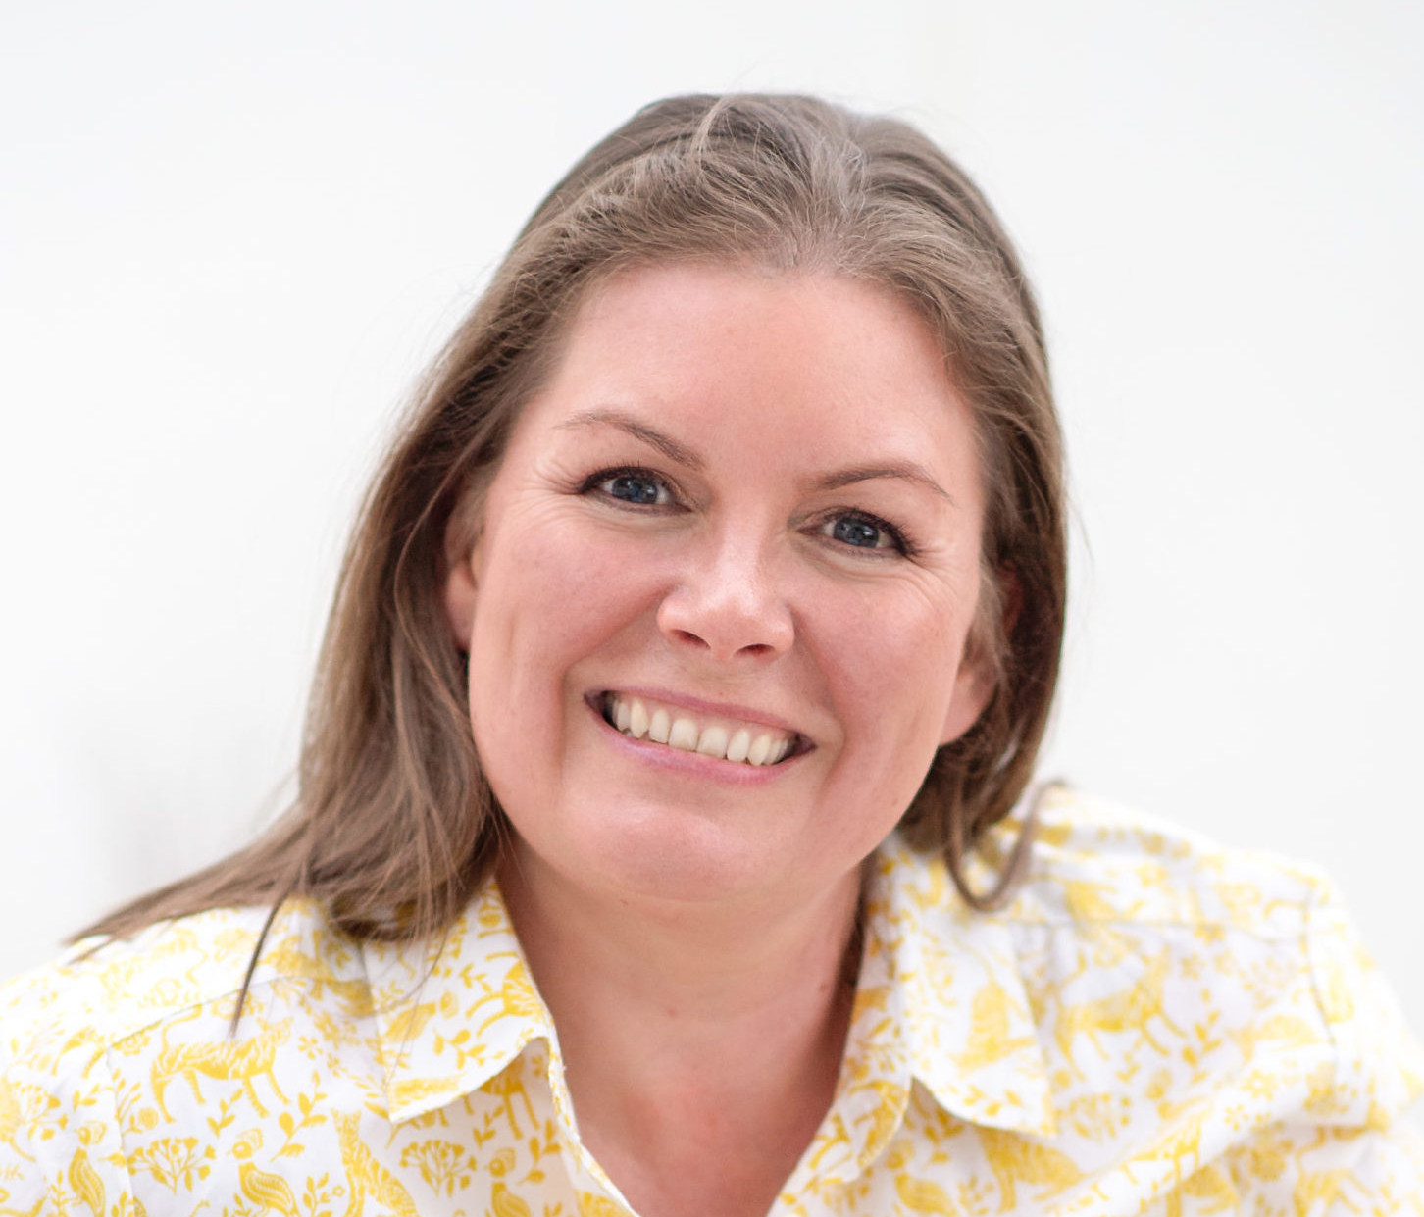
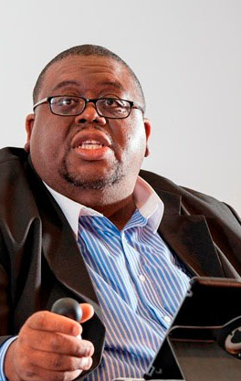
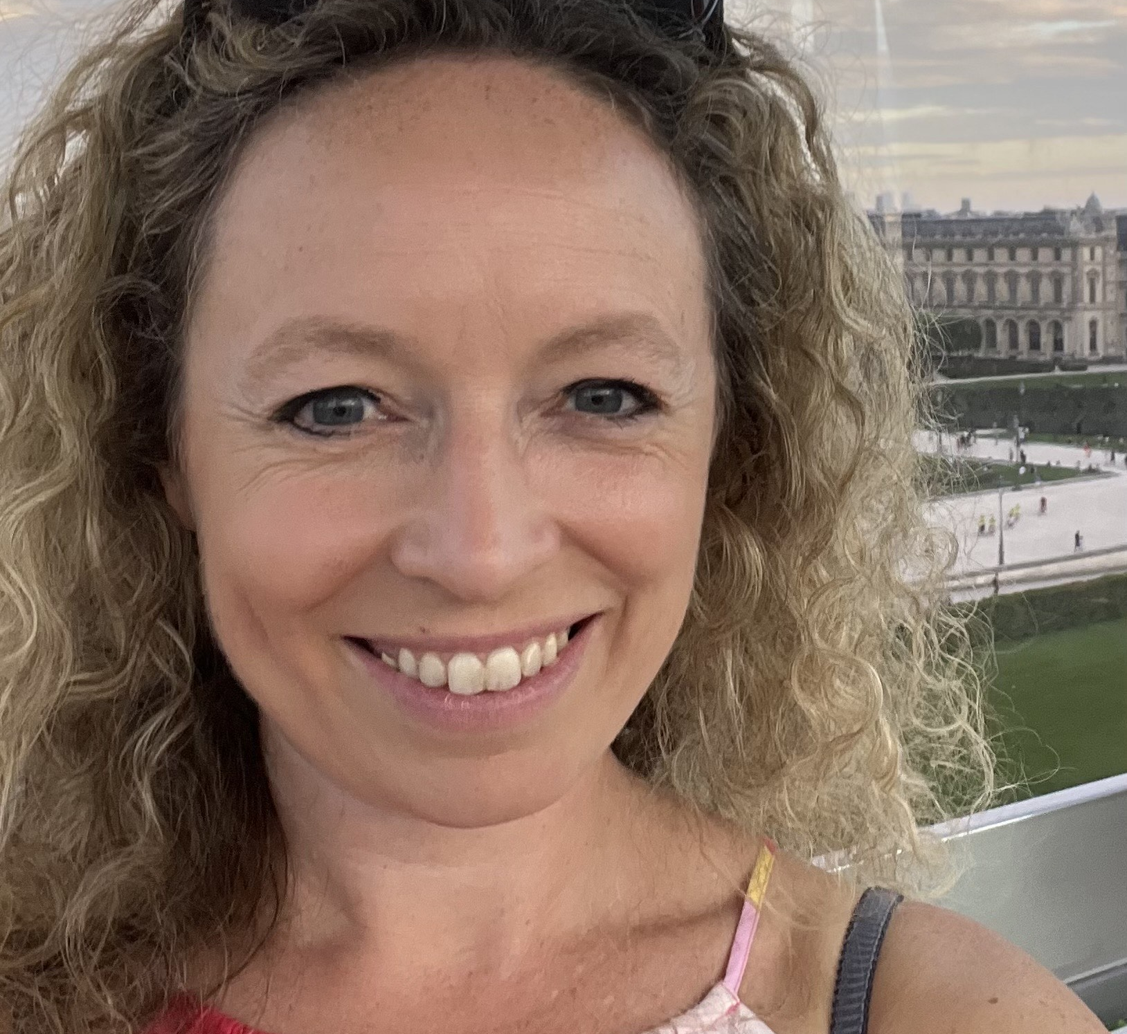
Who are we ?
Dr. Clenton Farquharson CBE
Thematic lead for Lived Experience, Senior Leadership Team of IMPACT
Karen McCormick
Lived Experience Engagement Lead
Laura Griffith
Deputy Head of National Embedding

Slide 4
About us - IMPACT
An implementation centre (not a research centre) – to support the use of evidence in the realities of practice and to improve services and lives​
We have an inclusive definition of ‘evidence’ (knowledge gained from different types of research, the lived experience of people using services and their carers, and the practice knowledge of social care staff)​
Very embedded in the realities of local practice, but also committed to building lessons learned into national policy and practice

Slide 5
Objectives
Increasing
Increasing the use of high-quality evidence, leading to better care practices, systems and outcomes
Building
Building capacity and skills in the adult social care workforce to work with evidence of different kinds to innovate and deliver better outcomes
Developing
Developing relationships between a wide range of stakeholders across the sector, to improve outcomes for people who draw on services and their families
Improving
Improving understanding of what elements of evidence implementation do and do not work in practice, and using this to overcome barriers

Slide 6
The way we work – delivery models
Demonstrator
Facilitators
Networks
Ask IMPACT

Slide 7
Hosting a future IMPACT project
There is national application process to identify the sites and services who will work with us in 2024-25 (starting from Sept 2024)
It closes on 30th November 2023 and the full details are on the IMPACT website
We’re looking for a wide range of organisations (all types and sizes) and locations, across the UK
We particularly welcome applications from organisations that might not normally come forward (e.g. community- and user-led organisations, small organisations, organisations that might be struggling a little and really benefit from the support etc)
“Good support isn’t just about
‘services’ – it’s about having a life.”

Slide 8
How we take work forward – an example from Northern Ireland

Slide 9
Co-production in research Karen McCormick
The importance of co-production in research
Different ways to become involved with IMPACT
Stay in touch with us!

Slide 10
Add your own Brick!
What are the enablers that could help us achieve real coproduction in research?

Slide 11
Find out more about our projects, people and progress:
@ImpAdultCare
https://impact.bham.ac.uk/

