Slide 1
Creating inclusive imagery
How to show ageing from a new perspective 19 October 2023
Dora Buckle
Digital Marketing and Content Manager
Notes:
Thanks for the introduction
My name is Dora and I’m the Digital Manager at the Centre for Ageing Better. We're a charity that tackling inequalities in ageing. We're working to make our homes and workplaces suitable for us as we get older, as well as challenging negative attitudes about ageing. We’re funded by the national lottery community fund.
One of the projects we’ve done in relation to our work to challenge ageism is our age-positive image library, which I manage and I’ll be talking about. Quick look ahead: I'll be discussing our image library in relation to how photos influence our perceptions of older people and social care. This session will be a mixture between me presenting and some interactive elements with some break out groups, so I really welcome all your contributions today

Slide 2
Are current images inclusive?
Notes:
Firstly, we need to explore the current landscape.
Are the photos used in the UK, across different sectors like media, advertising and charities representative or inclusive when it comes to age? Are they inclusive when it comes to social care? Do they reflect people's reality? Are they accurate to people's experience ?

Slide 3
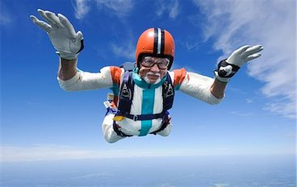
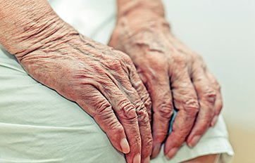
Depictions of older people
Older people are presented as more of a burden than a benefit
There is a dearth of images of older people, particularly older women and disabled older people
Images aren’t representative or realistic
Notes:
As part of our work looking into UK’s attitudes towards ageing, we’ve published several reports and done extensive research into how imagery can affect how people perceive getting older.
Our research found that within the print media especially, older people are represented as more of a burden than a benefit, described as "frail non-contributors to society“- which is a common stereotype about people who draw on care and support as well.
It also showed that there’s a real lack of images of older people in general, particularly older women and disabled older people, and people from different ethnic minority backgrounds.
The two examples included here are often the stereotypes found – extremes of either affluent and remarkable older people skydiving or people who are reduced to wrinkly hands and dehumanised

Slide 4
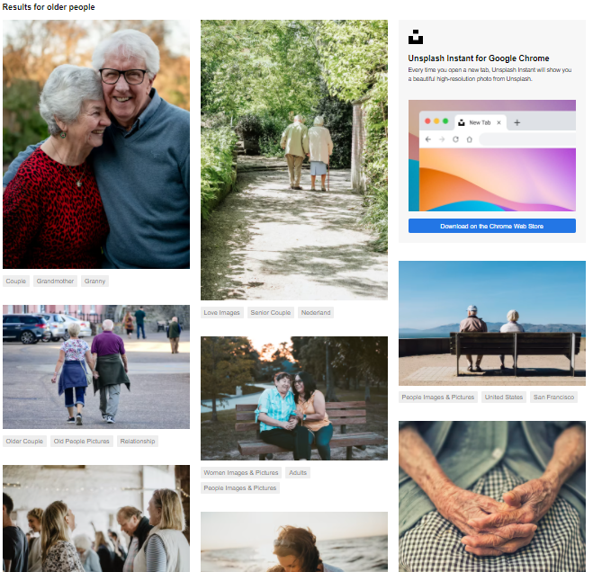
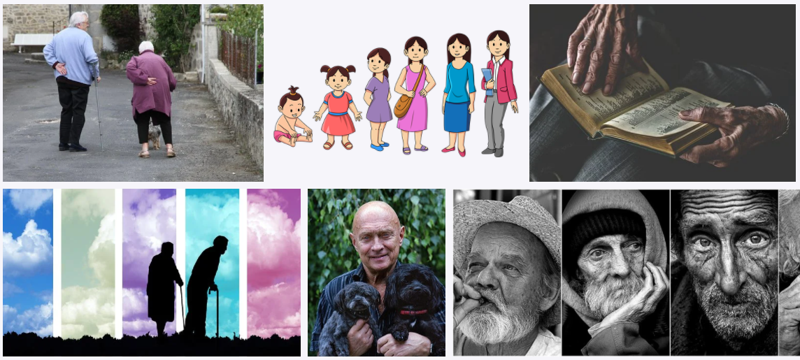
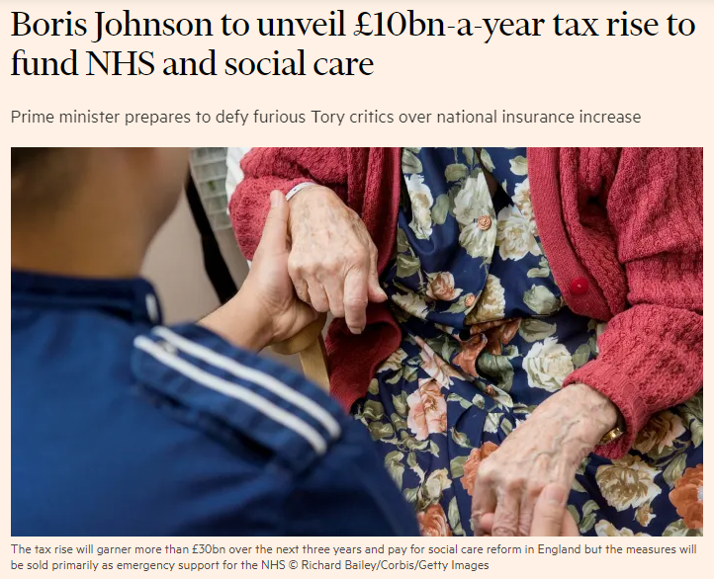
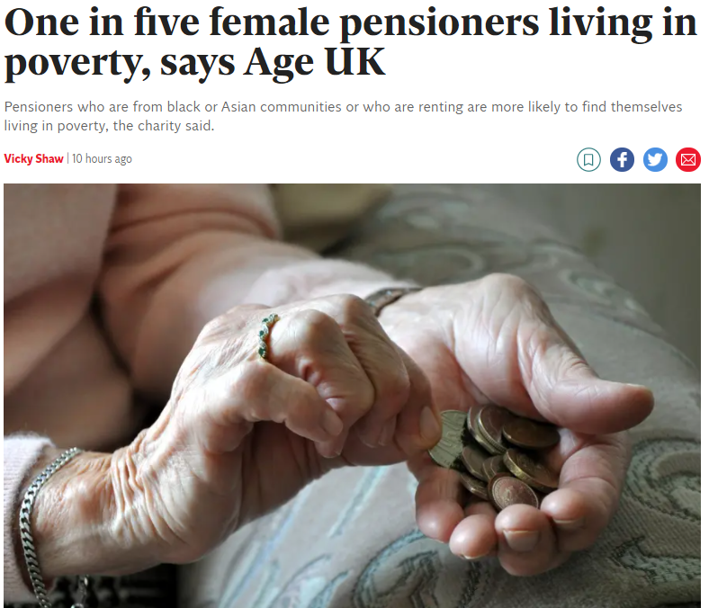
Notes:
Here are some more examples of images that appear in the media regularly and that are the some of the first results in google and image libraries

Slide 5
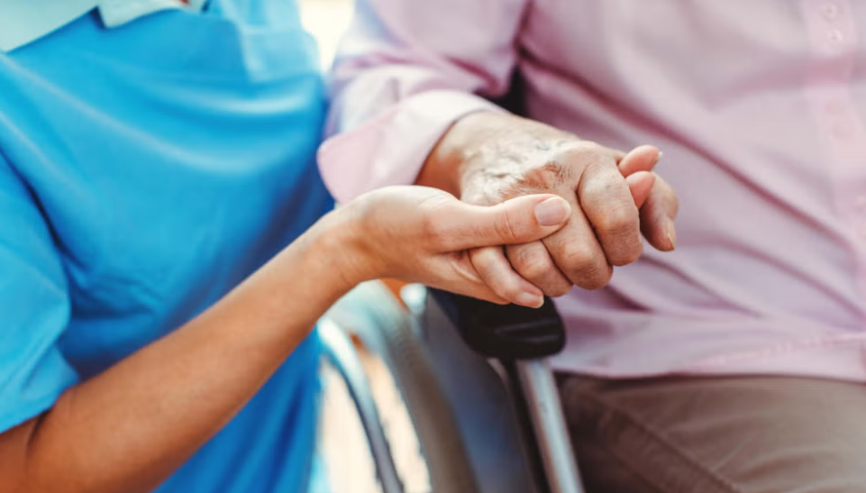
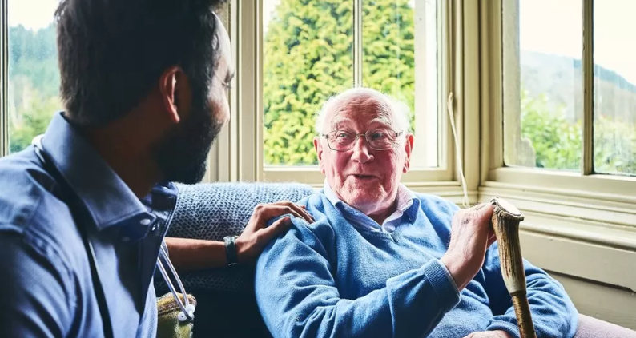
Notes:
On this slide, you can see what comes up when I google search 'social care' just last week. You can see the parallels really strongly.

Slide 6
First break out
What stereotypes are present in these photos?
Are there any other visual stereotypes of older people and social care not pictured that you're also sick of seeing in newspapers or online?
Notes:
*first activity* what stereotypes are present in these photos? Are there any other stereotypes around older people and/or social care not pictured that you're also sick of seeing in newspapers or online? 5 minutes- bring back together- different options Put top two on whiteboard
*After activity*
As you can see from these photos from a google search of older people, unfortunately, we’re highly reliant on outdated and negative stereotypes. As I mentioned in the previous slide, I'm sure we've all seen the 'wrinkly hands' photo accompanying an article talking about older people, as well as the icon of an older person using a walking stick. These depictions reinforce the notion that older people are disempowered, with little agency of their own. Its dehumanising. There's also a worrying lack of diversity, not only of ethnicity, but of age (people of all ages draw on care and support, people of all ages can be carers), lack of photos of peoples faces (hands only)

Slide 7
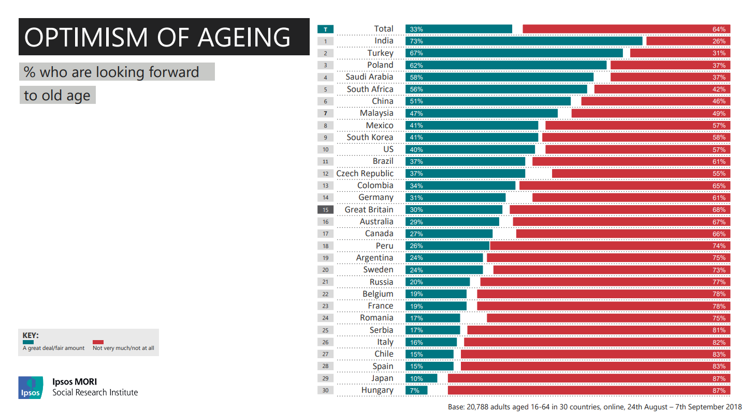
Notes:
So, why is this important? ​
​
Images undeniably contribute to how we feel about ageing – they set the tone of what we associate about later life,​ from the news articles we read about ageing to the adverts we see about getting older.
​
Overall, we’re pretty downbeat about later life – in a piece of research Ipsos conducted, only a third of people in the UK said they were looking forward to older age. ​Two thirds said they're not looking forward to older age.
​
The way we feel about ageing matters – It affects our actions and behaviour, how we feel about and interact with older people. ​
​

Slide 8
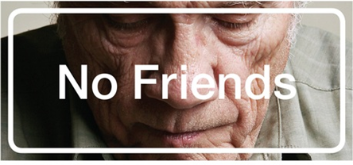
The power of images
Negative stereotypes reinforce negative societal narratives, such as the idea that ageing is an inevitable process of physical and mental decline
Ageism has broad and far-reaching negative consequences
Notes:
The power of images is a cycle. Negative stereotypes reinforce negative societal narratives.
For instance, in focus group discussions in our research, younger age groups viewed later life as something to be feared with an increased likelihood of loneliness.
As we know, it's not necessarily that some older people aren't lonely, as many are! It's more about that stereotype being one of the few visual representations of older people we see, so it becomes dominant in people's minds. And we know that loneliness is not just reserved for over 65s, in fact people at younger ages just as likely to experience it
My point is that like all age groups, those aged 50+ are not a homogenous group of people. We need more nuanced images that reflect the diversity of getting older as well as social care.

Slide 9
What have we done about it?
Notes:
So, we know that there’s a problem with images not being positive or challenging stereotypes when it comes to age – what have we at Ageing Better done about it?

Slide 10
Age-positive image library
Notes:
In January of 2021 we created a free, public image library. Now, it contains over 3,000 photos and icons that represent people aged 50+, available for use by any person or organisation. .

Slide 11
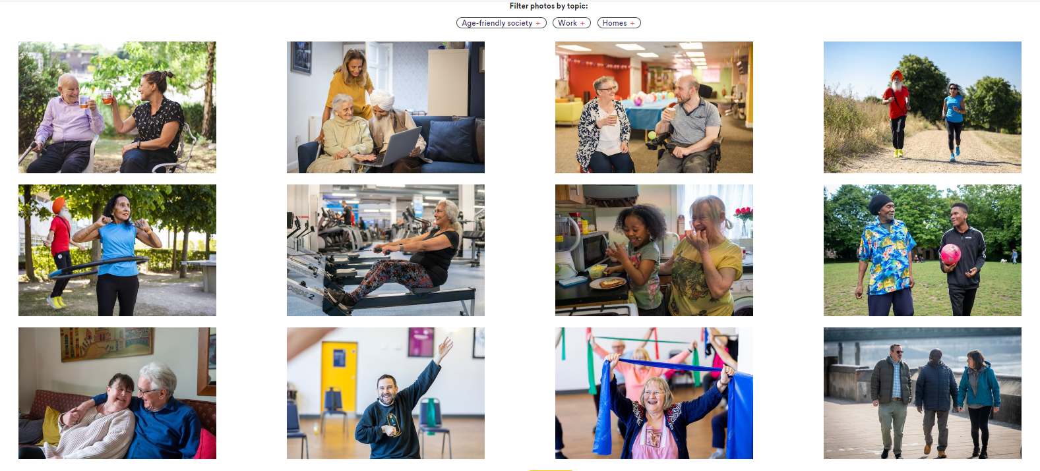
Tackling stereotypes
Notes:
The process involved commissioning photographers and working with them on briefs.
We don't use models wherever possible, these are volunteers sharing their lived experience and we’re open to people giving us feedback into how they want to be portrayed. We do offer payment for these volunteers, if they want.

Slide 12
Tackling stereotypes
Notes:
Older unpaid carers are were given the spotlight in this collection, we released a series of images illuminating the hidden and often underappreciated work of older unpaid carers as well as their lives outside of caring.
The project provides snapshots of older unpaid carers from Touchstone’s Sikh Elders Service and Bramley Elderly Action, both in in Leeds, and the Carers Centre Tower Hamlets.

Slide 13
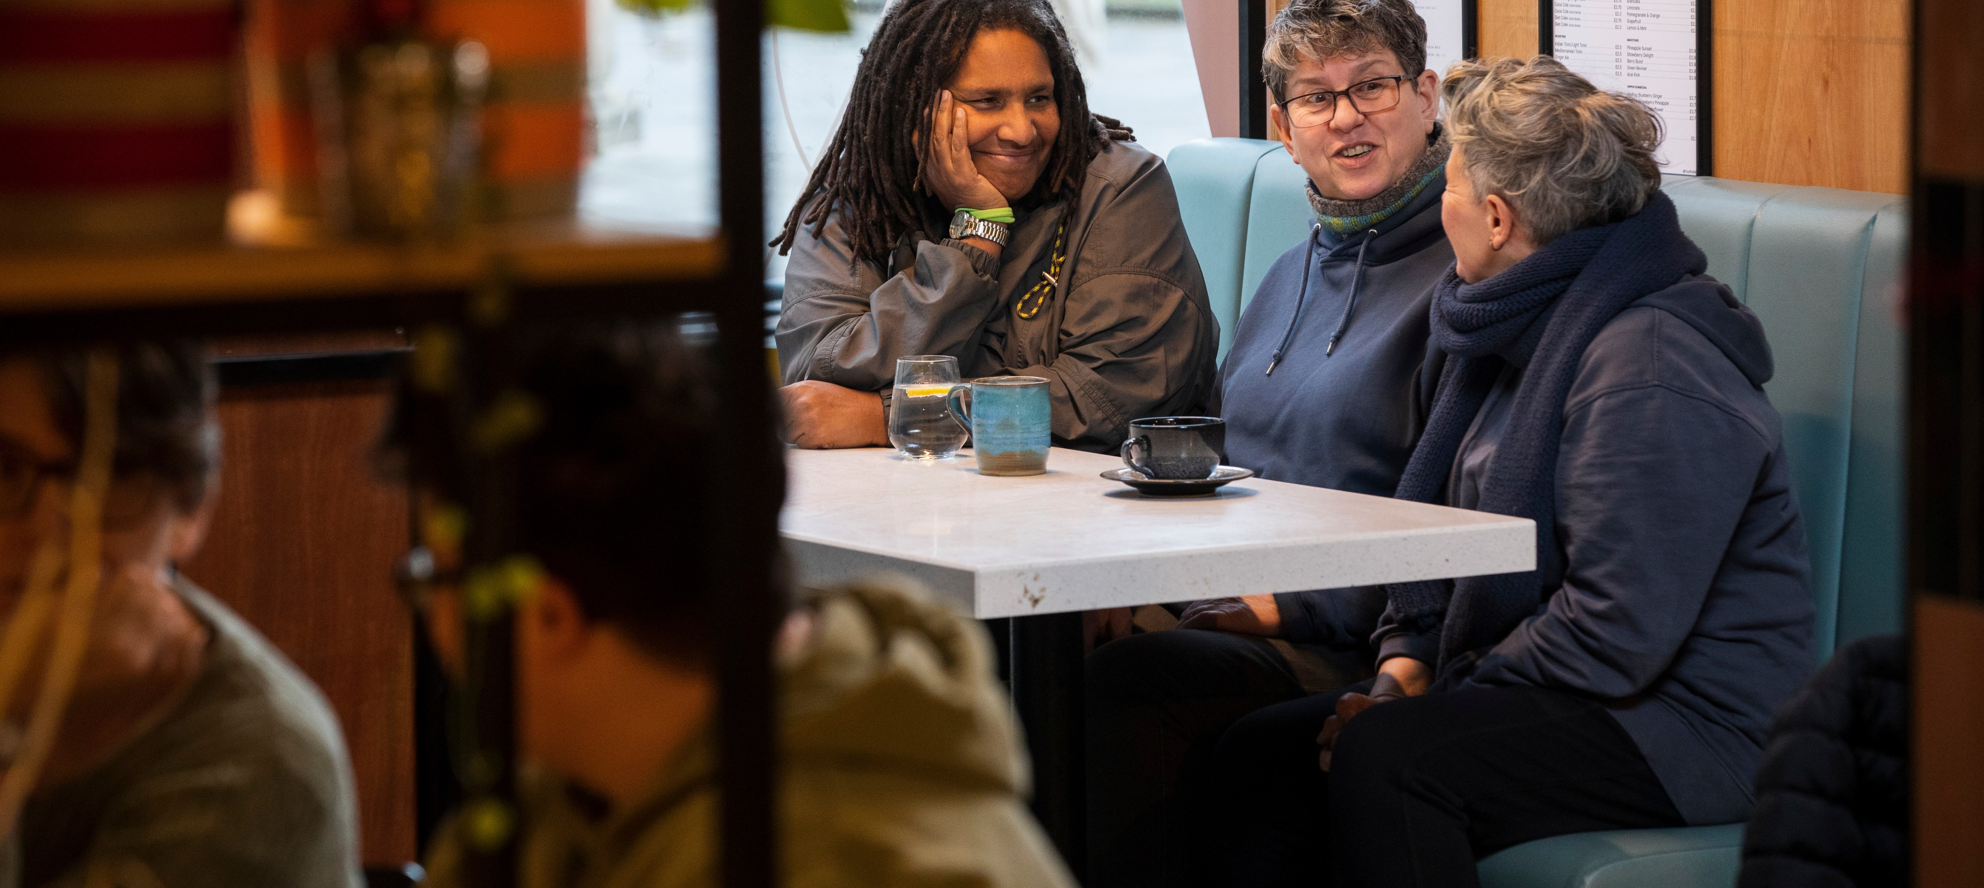
Tackling stereotypes
Notes:
Here’s a photo from a collection we worked on in partnership with Independent Age. The collection has 700 photos, as well as quotes of people we photographed. This project hopes to both amplify participants’ voices and increase the visibility of the underrepresented communities involved.
These photos sought to illustrate the experiences of people who are often underrepresented – those who live on low incomes, identify as LGBTQ+ or are aged 70 and above.

Slide 14
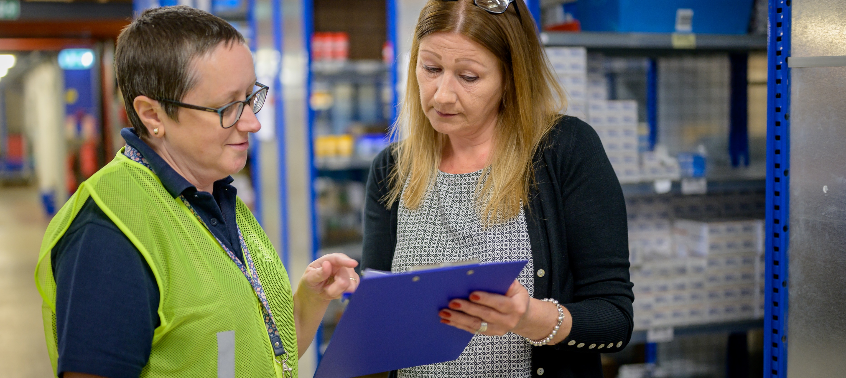
Tackling stereotypes
Notes:
This collection, titled A Woman’s Work, featured more than 200 photos of women aged over 50 in their workplaces, in a range of settings including offices, cafés and warehouses.
The collection responds to the lack of images of over 50s, and particularly older women, in print media, magazines, and advertising.

Slide 15
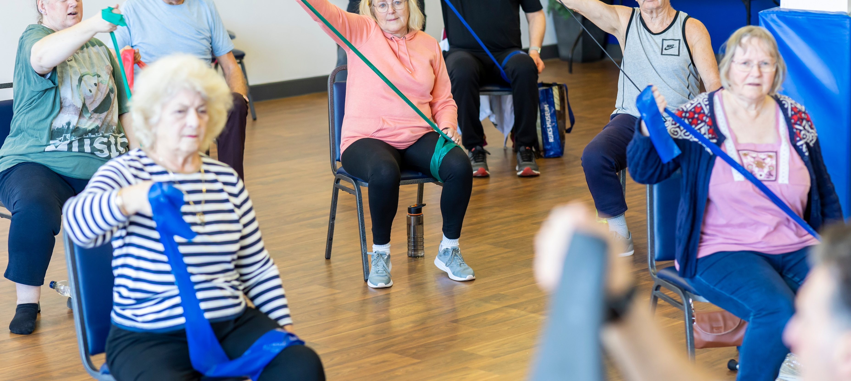
Tackling stereotypes
Notes:
Together with Get Yourself Active at Disability Rights UK we launched Picture Yourself Active: over 300 photos depicting older and Disabled people getting active to challenge pervasive negative stereotypes. The library contains positive and authentic images of older and Disabled people – and the intersectionality between the two – getting active. We also wanted to show that that not all disabilities are visible by including a range of experiences that are often not recognised within society.

Slide 16
What can you do about it?
Use realistic portrayals
Don’t ignore diversity
Consider the context
Be open-minded
Notes:
We’ve also published guide on using the image library and capturing your own age-positive images if you'd like more detail, but I’ll quickly flag the main points now (a lot of this is transferrable to photographing social care situations too)
Use realistic portrayals – The most important thing to consider is using images that don’t use unrealistically positive or negative depictions of people in later life
The library needs to be positive to challenge those negative stereotypes I talked about earlier but that it also be realistic. For instance, if someone did need a walking aid, we wanted the photos to include that. If someone was exercising we didn't want it to seem completely effortless, because that's not natural. And not everyone has to be smiling all of the time, especially if the photos depict a serious situation. Photographs, if done properly have room for these nuances.
2. Don’t ignore diversity
It was also very important to us to depict a diverse range of people to ensure an accurate representation of the population. This obviously encompasses age but also gender, race and ethnicity, religion, disability, sexual orientation and geography.
3. Consider the context – Imagery, like verbal and written language, can strongly influence our attitudes and views
– When selecting imagery for your campaign, think about the context and what your photo is being used to portray. Be careful to not dehumanise or make insinuations with your choice of image when accompanying a news piece or blog for example
4. And finally, it’s a learning process – no organisation or person is perfect and inevitably mistakes we’ll be made. So keep an open mind and learn from others, take criticism and try to do better both our image library and your contribution to changing the visuals of getting older, in with Social care future's 'A MOVEMENT FOR GLORIOUSLY ORDINARY LIVES' action orientated initiative. Narrative power: we will develop tools and the knowledge that we need to tell different and compelling stories, focusing on the role of people with lived experience

Slide 17
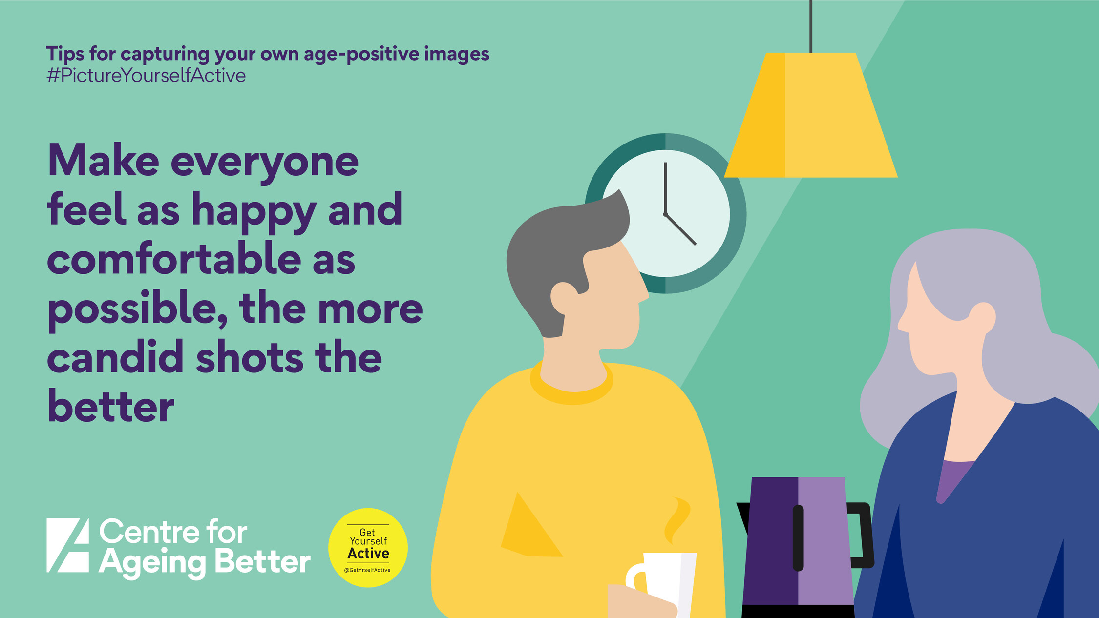
More tips for capturing your own age-positive images
Notes:
We also worked alongside Get Yourself Active (part of Disability Rights UK) and produced a set of Dos and Don'ts for tips on capturing your own disability and age-positive images, which I think are quite applicable here for empowering you to take your own inclusive photos.

Slide 18
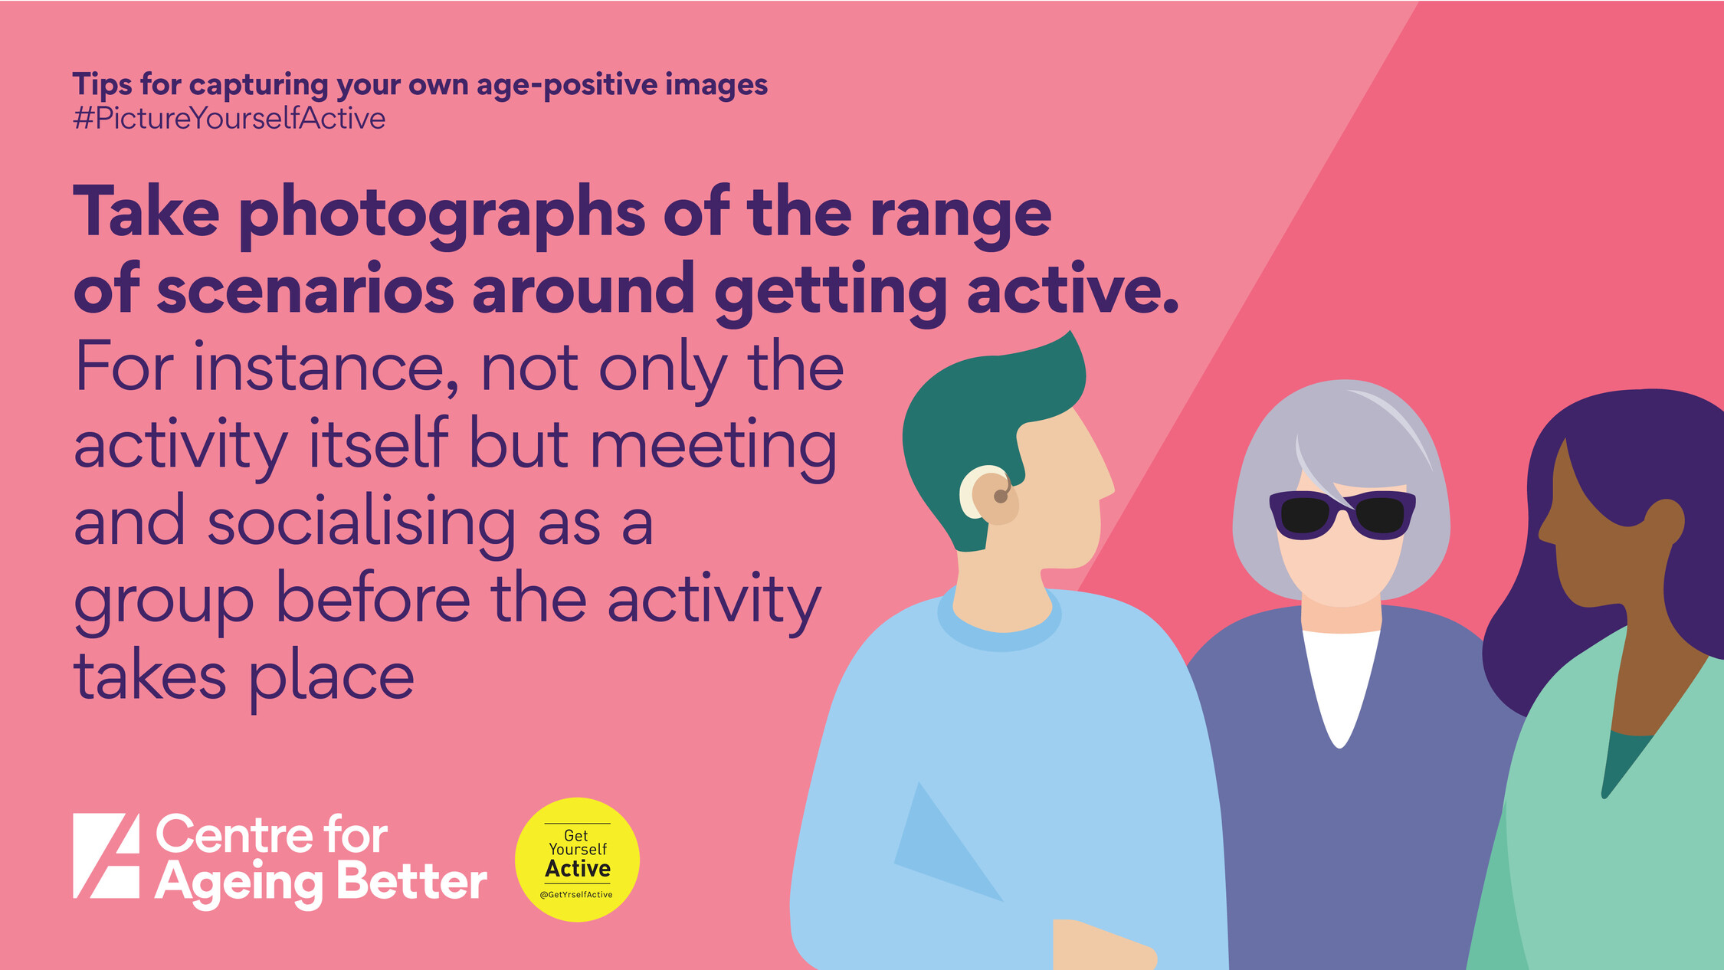
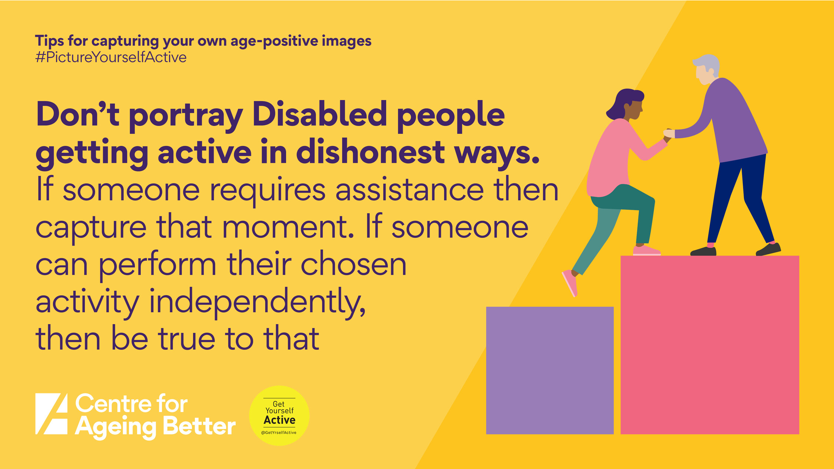
More tips for capturing your own age-positive images
Notes:
We also worked alongside Get Yourself Active (part of Disability Rights UK) and produced a set of Dos and Don'ts for tips on capturing your own disability- and age-positive images.

Slide 19
The story so far
Working with Pexels, Unsplash and the Noun Project to reach a wider audience
Working with Alamy on a photography competition
Our photos have been viewed over 50 million times and downloaded over 200,000 times
Notes:
Library has been really successful – over 300,000 downloads of images. The overwhelmingly positive response to our image library shows us just how much appetite there is for positive photos that reflect a reality that’s more in line with people’s experiences of getting older.
Since launching the library, several stock image libraries including Pexels, Unsplash and the NOUN project we now have partnerships with them-now we're very excited to be working with Alamy on this photography competition.
We have more photos coming out in the next few months, so watch this space!

Slide 20
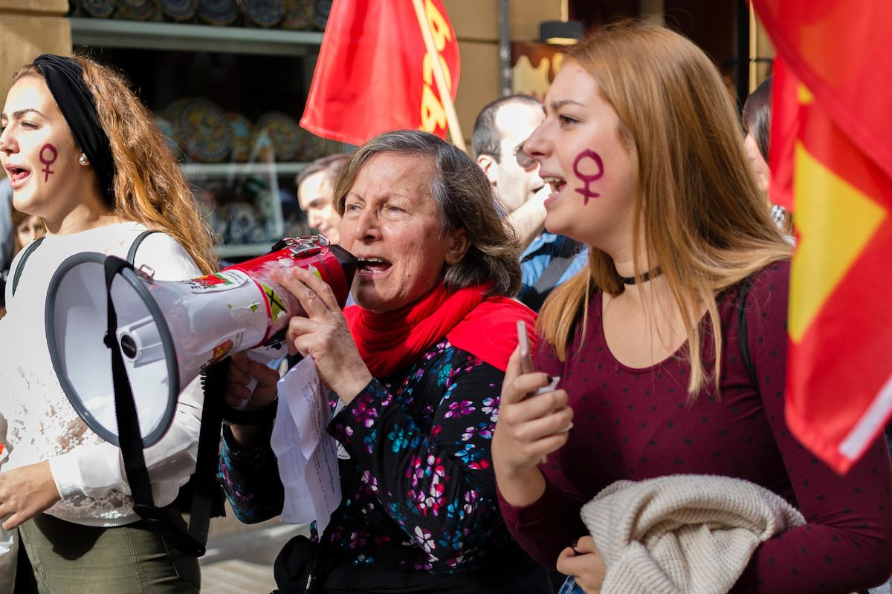
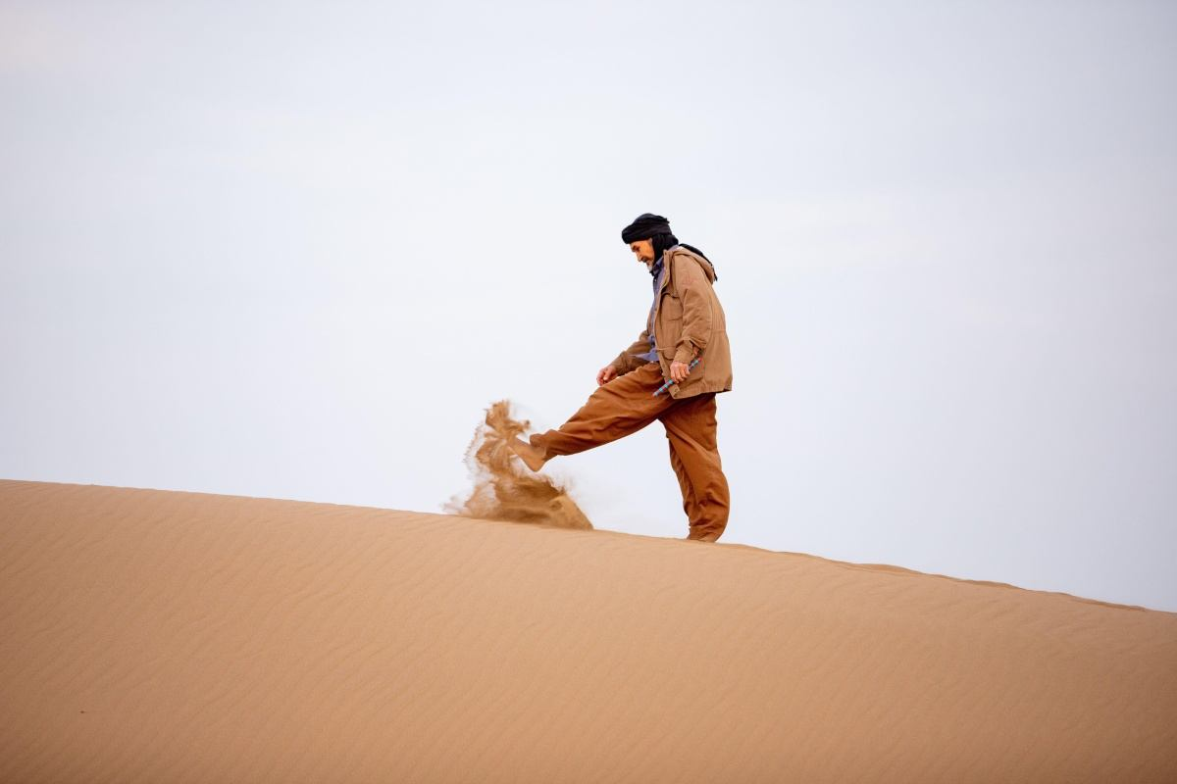
Competition with Alamy
Earlier this year, Ageing Better and Alamy launched a joint competition inviting photographers to submit images challenging stereotypical depictions of older people. The competition was created to raise awareness of negative representations of ageing and encourage contributors to find new ways to show over 50s in a more positive manner.
The entries show older people taking part in their daily lives whilst avoiding the stereotypes typically present in stock imagery.
Notes:
Earlier this year, Ageing Better and Alamy launched a joint competition inviting photographers to submit images challenging stereotypical depictions of older people.
The competition was created to raise awareness of negative representations of ageing and encourage contributors to find new ways to show over 50s in a more positive manner.
The entries show older people taking part in their daily lives whilst avoiding the stereotypes typically present in stock imagery.
Eg- here's an example of something we did recently Alamy, the world’s most diverse stock photography collection with around 150,000 images added every day by thousands of photographers from across the world, and the Centre for Ageing Better, a charity pioneering ways to make ageing better a reality for everyone, including launching a campaign to challenge ageism later this year.
Entries were received from a range of countries including Bulgaria, the Maldives, Sweden and Canada- was really inspiring to see the photos that came through
*next interactive element* In your experience of seeing and using images of social care, what photos would you like to see more of, or would you take yourself? (5 minutes)- SEE NEXT SLIDE FOR EXAMPLE
Ask people for feedback and respond.

Slide 21
Thank you
dora.buckle@ageing-better.org.uk
Notes:
We want to use this success to grow the library even more, offer more images, change how media use photos and normalise the contributions of older people across society. We hope that these photos can be a useful resources for people. I believe that they can help to support a more nuanced, positive and realistic dialogue about getting older. We want all older people, as well as social care and the lives of people who draw on it to be accurately and positively represented. And there's no one way to 'fix' this, but an important part of improving representation is the photos and imagery we use All the photos used in this presentation are part of our image library. You can view and download 3,000 more by accessing the library on the Ageing Better website.
Thanks for listening, if you have any questions I'd be happy to answer them

